Slide 1

Advocacy: Taking Action
Change Agent Network Forum
November 16, 2017

Slide 2
Welcome
Notes:
NAME: Raquel
NOTE: NA
SCRIPT: NA

Slide 3




Why CAN Forums?
Change starts with an initial, often highly personal, commitment to engage and move forward.
-Dr. Paul Light, Driving Social Change, 2011
Notes:
NAME: Raquel
NOTE: NA
SCRIPT: CAN Forums were created to strengthen a network of change agents.
Vitalyst’s goal is for you to leave today’s session knowing other people, knowing that you are not alone, and with some practical skills and resources to build a stronger more effective organization.
This starts with self , like a drop in the water, and has the possibility of becoming a wave of transformation.

Slide 4


CAN Forum
Continual Learning
-
Self Motivation
Notes:
NAME: Raquel
NOTE: NA
SCRIPT: Please keep in mind. CAN Forums are a high level introduction to subjects that are often complex.
We respect and appreciate the diversity of experience on complex topics because it enriches the conversation, connects people with others who may have a different skill set and lived experience,
and because acknowledging together that something is complex is one step to knowing we are all in this together.

Slide 5
Agenda
Vitalyst Health Foundation overview
Introductions
Marcus Johnson, Vitalyst – What is policy and how does it move?
Madeline Morcelle, JD, MPH, the Network for Public Health Law – What is lobbying and where do I draw the line?
Eric Meyer, MD, Former AZ State Representative, Connecting with policy makers
Taking Action: Where are we, where might we go?
Notes:
NAME: Jennifer
NOTE: NA
SCRIPT: NA

Slide 6
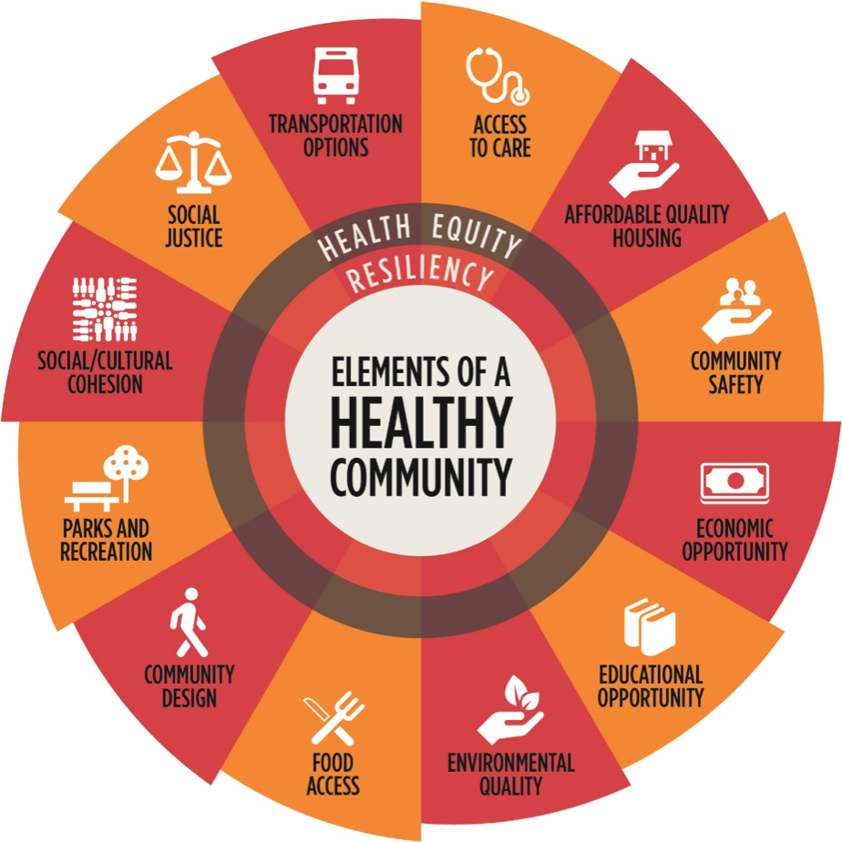
Table Introductions
Name
Organization/Affiliation
Briefly describe where your work fits into the Elements of Healthy Community
August 24, 2017
Notes:
NAME: Jennifer
NOTE: Refer to the handout in their folders
SCRIPT: Please share your name, organization, and where your work fits into the elements of healthy communities- just among your table.

Slide 7
Specific Desired Results of Today’s Session
Clarify role in public policy and advocacy
Understand what constitutes “lobbying”
Learn how to craft a message that resonates with decision makers
Identify various strategies to move policy
Understand how and when to engage policy makers
Notes:
NAME: Jennifer
NOTE: None
SCRIPT: Desired results set the ground for expectations about what we are trying to achieve in this session…

Slide 8
Dr. Raquel Gutierrez
Director of Strategic Learning & Practice
Vitalyst Health Foundation
Rgutierrez@VitalystHealth.org
www.VitalystHealth.org
(602) 385-6500
Jennifer Bonnett, MPA
JHB Executive Consultants
jennifer@jhbconsultants.com
www.jhbconsultants.com
(602) 529-4697
Notes:
NAME: NA
NOTE: NA
SCRIPT: NA

Slide 9
What is Policy and
How Does it Move?
Change Agent Network Forum
November 16, 2017
Marcus Johnson
Director, State Health Policy & Advocacy
Vitalyst Health Foundation
mjohnson@vitalysthealth.org
602-385-6503

Slide 10
policy [päləsē]
noun
A course or principle of action adopted or proposed by an organization or individual.
Source: https://en.oxforddictionaries.com/definition/policy

Slide 11

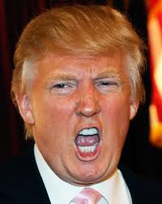
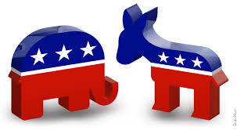

Perception of Policy

Slide 12

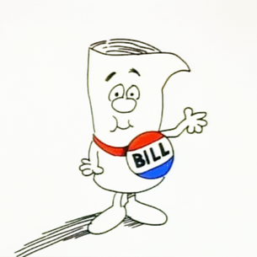
Perception of Policy

Slide 13
Reality of Policy

Slide 14

Reality of Policy

Slide 15
Scale of Policy
State budget changes education funding
P
School board changes district objectives
P
Teacher creates lesson plans
P

Slide 16
Why Policy?

Slide 17
Spectrum of Prevention
Strengthen Individual Knowledge & Skills
Promote Community Education
Educating Providers
Foster Coalitions & Networks
Change Organizational Practices
Influence Policy
Source: The Prevention Institute - https://www.preventioninstitute.org/publications/spectrum-prevention-developing-comprehensive-approach-injury-prevention

Slide 18

Strengthen Individual Knowledge & Skills
Promote Community Education
Educate Providers
Foster Coalitions & Networks
Change Organizational Practices
Influence Policy

Slide 19
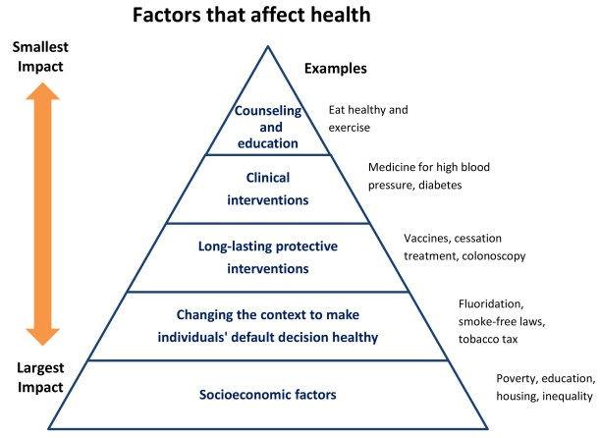
Health Impact Pyramid
Increasing Population Impact
Increasing Individual Effort

Slide 20
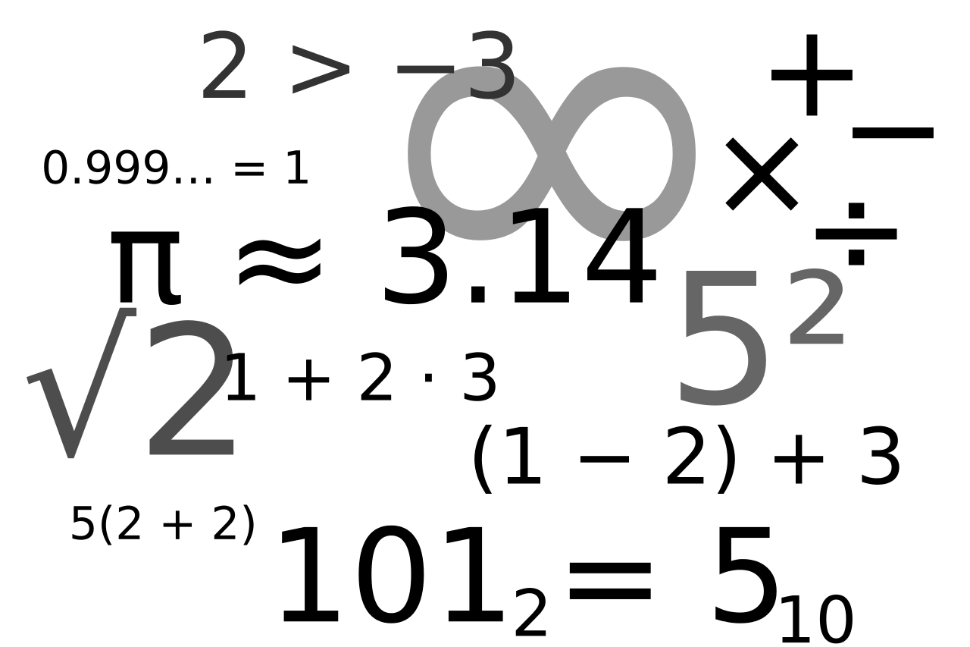

Policy
Advocacy

Slide 21

Breaking Down Silos
Sectors
Healthcare
Education
Worksites
Community

Slide 22
Breaking Down Silos
Disease States
Substance Abuse
Diabetes
Oral Health
Cancer

Slide 23
Breaking Down Silos
Policy Makers
Advocacy Groups
Proximity to People
Program Managers
Front Line Workers

Slide 24
What can you do?
Policy Makers
Advocacy Groups
Proximity to People
Program Managers
Front Line Workers

Slide 25
Give a man a fish?
Teach a man to fish?
Build a lake.
Action
Desire/Will
Awareness
_ A D V O C A C Y_________

Slide 26
Policy & Advocacy
Engagement Strategies
When you think about ADVOCACY, what comes to mind?

Slide 27
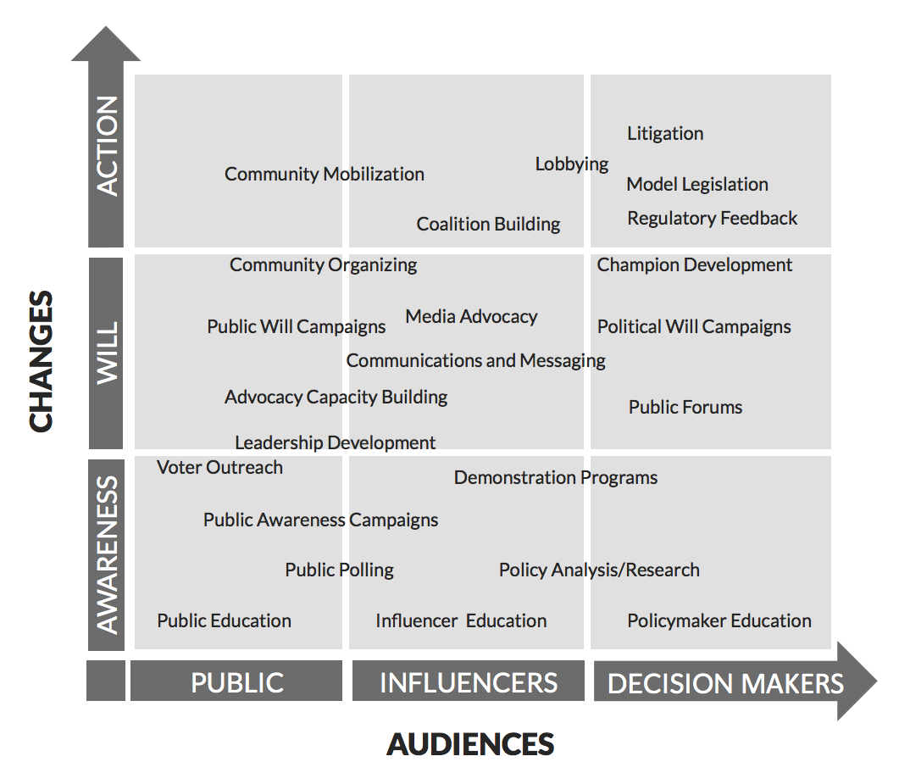
A Framework for Taking Action
Source: Evaluation Innovation http://www.evaluationinnovation.org/sites/default/files/Adocacy%20Strategy%20Framework.pdf

Slide 28
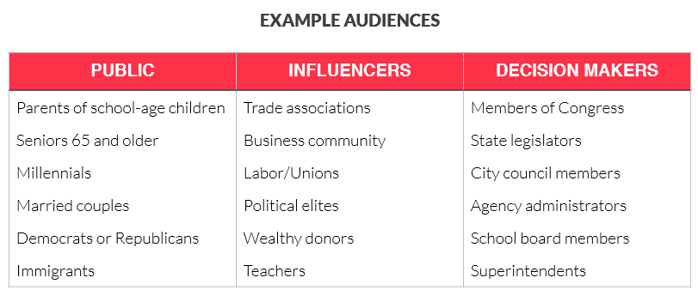
Know Your Audience
Who needs to do something differently than what they’re doing right now?

Slide 29
Source: Evaluation Innovation http://www.evaluationinnovation.org/sites/default/files/Adocacy%20Strategy%20Framework.pdf

Slide 30
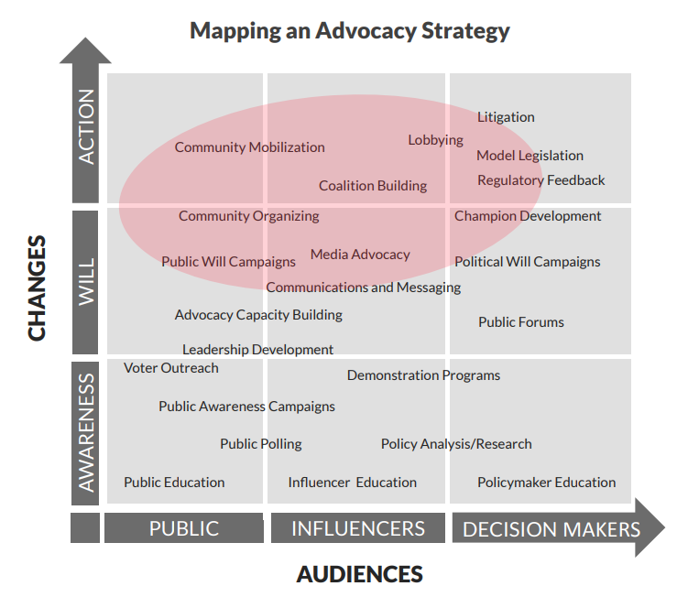

Slide 31
Where to Take Action?
Where does the change need more advocacy, according to the two axes?
Source: Evaluation Innovation http://www.evaluationinnovation.org/sites/default/files/Adocacy%20Strategy%20Framework.pdf

Slide 32
To Consider:
Who else is working on this issue?
  Support and Opposition
Clarify assumptions about how change occurs
  e.g., Grassroots vs Insider Advocacy, Community vs Industry-Lead
    Either/Or vs Both/And

Slide 33
Where to Take Action?
Where does the change need more advocacy, according to the two axes?
Source: Evaluation Innovation http://www.evaluationinnovation.org/sites/default/files/Adocacy%20Strategy%20Framework.pdf

Slide 34
Where to Take Action?
Where does the change need more advocacy, according to the two axes?
Look at the tactics and assess their appropriateness
Source: Evaluation Innovation http://www.evaluationinnovation.org/sites/default/files/Adocacy%20Strategy%20Framework.pdf

Slide 35
Where to Take Action?
Where does the change need more advocacy, according to the two axes?
Look at the tactics and assess their appropriateness
Look at the tactics outside of your scope and ask “why?”
Source: Evaluation Innovation http://www.evaluationinnovation.org/sites/default/files/Adocacy%20Strategy%20Framework.pdf

Slide 36
To Consider:
Who else is working on this issue?
  Support and Opposition
Clarify assumptions about how change occurs
  e.g., Grassroots vs Insider Advocacy, Community vs Industry-Lead
    Either/Or vs Both/And
Consider the role of the public in creating and sustaining change
Consider the role of PR/communications throughout
How might contextual shifts (political, social, economic) alter your strategy?

Slide 37
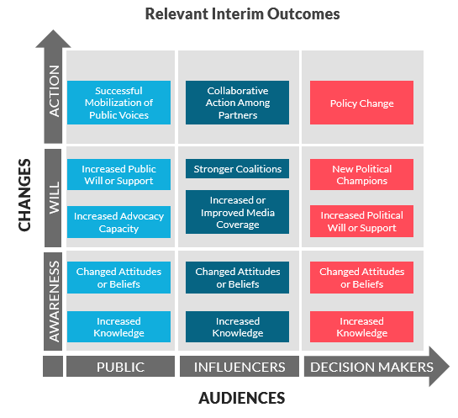
Are We Moving the Needle?

Slide 38
Questions?
Later in the Day: Putting the framework into action

Slide 39
Demystifying Lobbying:
A Primer for Public Health Advocacy
Madeline Morcelle, JD, MPH
Notes:
advocacy–essential to public health progress, and demystify lobbying, which is just one advocacy tool, can empower key stakeholders to move the needle for public health

Slide 40

Value of Public Health Law
Laws can solve public health challenges:
  Second-hand smoking laws
  Regulation of medical marijuana in the interest of public health
  Provision of emergency medical services
  Air bag requirements
  Vaccination requirements
Notes:
Public health law focuses on the government’s legal authorities and duties “to ensure the conditions for people to be healthy,” and how to balance these authorities and duties with individual rights.
The scope of public health law is broad and ranges from narrow questions of legal interpretation to complex issues relating to public health policy, ethics, and social justice
Here are some examples of how law can solve public health challenges.

Slide 41
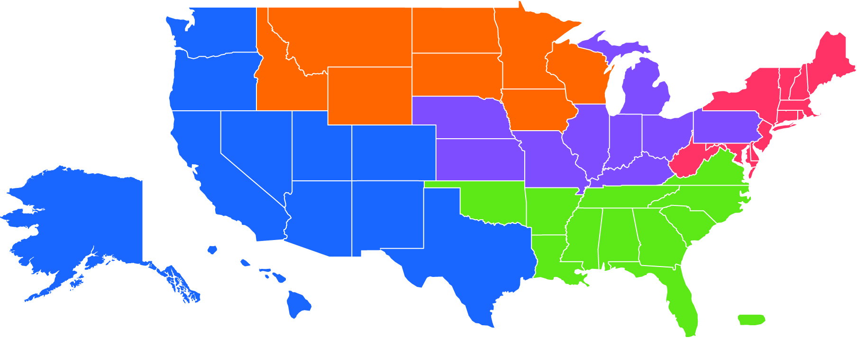
The Network for Public Health Law
  Provides legal technical assistance, training and resources to advance public health nationally
Technical assistance does not include providing legal advice or representation.
Notes:
national nonprofit
Provides legal technical assistance, training and resources to advance public health across the country
Divided into 5 Regions that provide local and state support

Slide 42
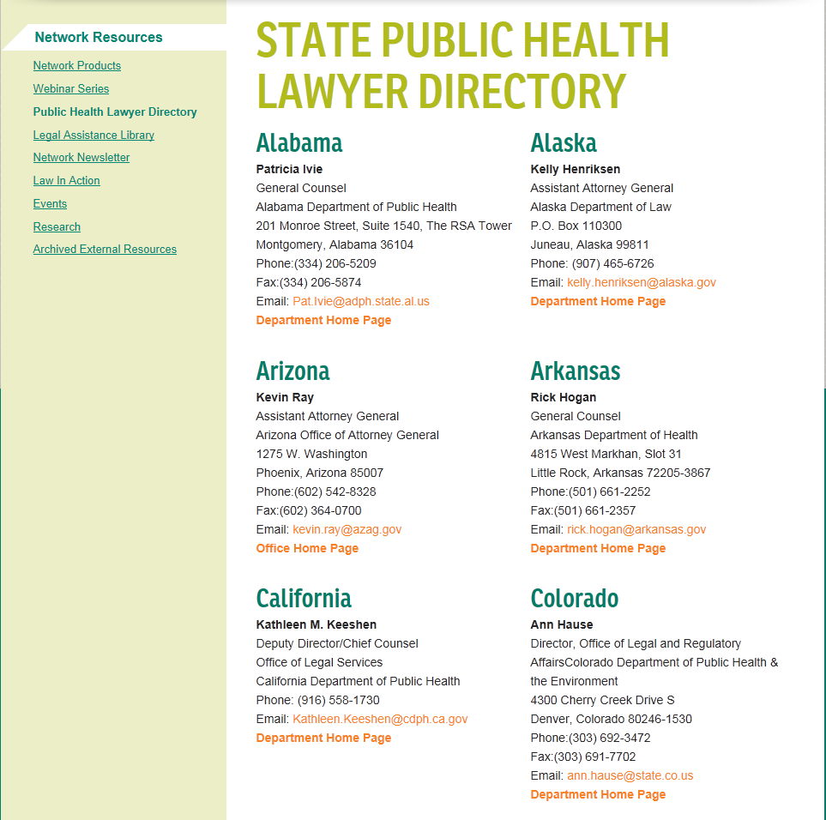

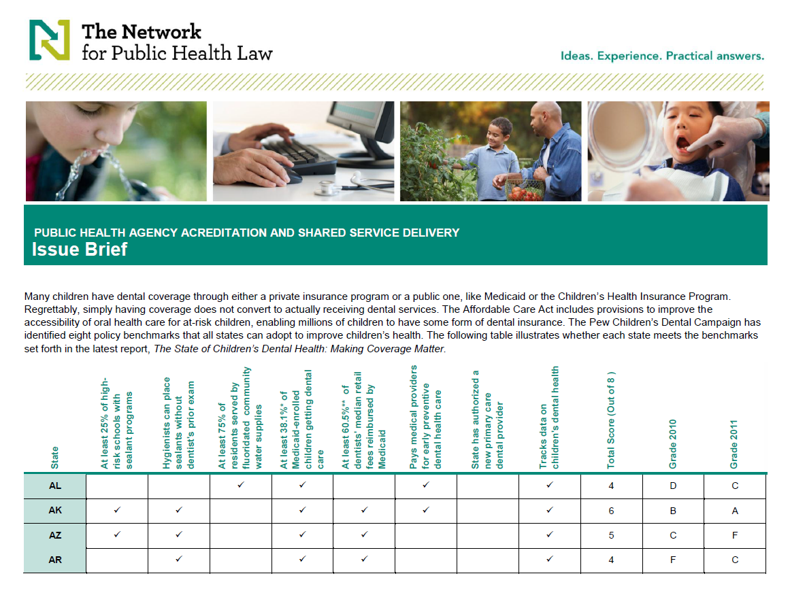
What We Do
  Technical Assistance*
  *Does not include legal advice or representation.
    Strategizing about potential legal options
    Help finding experts, resources and tools
    Support to develop, implement, and enforce legislation,
    statutes or regulations
  Resources
    Library of legal assistance questions and answers
    Network products, such as fact sheets, tables of
    state laws, legal briefs and more
    Public health lawyer directory
    Newsletters
    External resources
  Events and Webinars
Notes:
At no cost, the Network provides helpful legal assistance, training and resources to the public health community.
This includes….
Technical assistance does not include providing legal advice or representation.

Slide 43
Who can use the Network
Anyone committed to public health can join the Network and use its services, including:
  Local, state, tribal, and federal public health officials
  Public health practitioners
  Attorneys
  Policymakers
  Advocates
  Join the Network at no cost: http://www.networkforphl.org
Notes:
Transition to advocacy/lobbying

Slide 44
The Importance of Demystifying Lobbying
Notes:
W/ that introduction, turn our attention to demystifying lobbying.
It is common for public health stakeholders to avoid advocacy because of confusion around lobbying rules, but that total avoidance is both unnecessary and problematic.
Moving the needle on PH issues often requires legal and policy reform. law + policy changes require political will. Advocacy that shows that the status quo is no longer acceptable to stakeholders builds political will.
If public health stakeholders don’t advocate for public health, opposing sides will denigrate it.

Slide 45


Advocacy v. Lobbying: What’s the Difference?
Advocacy–“the processes by which the actions of individuals or groups attempt to bring about social and/or organization change on behalf of a particular health goal, program, interest, or population.”
Lobbying–just one tool in the advocacy toolbox
Notes:
Although all lobbying is advocacy, not all advocacy is lobbying.
Definitions of advocacy and lobbying
Advocacy includes a broad range of activities which attempt to influence a specific policy, legislative, regulatory or implementation outcome. Advocacy can include policy analysis, issue development, educating policymakers and the public, constituency organizing, lobbying, legal class actions, or creating an entire advocacy campaign.
Advocacy can include educating policymakers and the public about evidence-based policy
Lobbying is a specific means of doing this, subject to various rules, but typically boils down to communications attempting to influence specific legislation
Understanding the difference will empower your organization to engage in advocacy and avoid running afoul of lobbying rules.
To determine what is considered lobbying in a particular legal context, two key questions.
Advocacy def from: 2000 Joint Committee on Health Education and Promotion Terminology. (2002). Report of the 2000 Joint Committee on health education and promotion terminology.

Slide 46

Guiding Questions:
What Type of Entity Will Act?

Slide 47

Guiding Questions:
What is the Source of Funding?
Notes:
What’s the funding source for the activity?

Slide 48
Arizona Law

Slide 49
Arizona Law
Lobbying–attempting to influence (1) the passage or defeat of any legislation by directly communicating with any legislator or (2) any formal rulemaking proceeding by directly communicating with any state officer or employee.
A.R.S. § 41-1231(11)
Notes:
Iv not super relevant for the audience

Slide 50
Arizona Law
Lobbying does not include:
Interagency communications between state agency employees.
Communications between: (1) a public official or employee of a public body; (2) designated public lobbyist or authorized public lobbyist; and (3) any state officer, except for a member of the legislature, or an employee of the legislature.
Oral questions or comments made by a person to a state officer or employee regarding a proposed rule and made in public at a meeting or workshop . . .open to the public and that is sponsored by a state agency, board, commission, council or office.
Communications between a public body and [person or company] regarding the procurement of materials, services, or construction
  Some exceptions relating to other lobbyist registration requirements
A.R.S. § 41-1231(11)
Notes:
Iv not super relevant for the audience

Slide 51
Arizona Law
Principal–any person, other than a public body, who employs, retains, engages or uses, with or without compensation, a lobbyist.
Public body–a public entity that employs, retains, engages, or uses, with or without compensation, a designated or authorized public lobbyist.
Designated lobbyist or designated public lobbyist–secretary of state’s “point of contact” for the principal or public body.
Authorized lobbyist or authorized public lobbyist–a person other than the designated [public] lobbyist who is employed by, retained by or representing a public body, with or without compensation, for the purpose of lobbying and who is listed as an authorized [public] lobbyist.
Lobbyist for compensation–a lobbyist who is compensated for the primary purpose of lobbying on behalf of a principal and who is listed by the principal in its registration.
A.R.S. § 41-1231(16); A.R.S. § 41-1231(18); A.R.S. § 41-1231(12); A.R.S. § 41-1231(1); A.R.S. 1231(2); Arizona Department of State, Office of the Secretary of State, https://www.azsos.gov/elections/lobbyists.

Slide 52
Arizona Law
Registration Requirements
Principals, public bodies, and their lobbyists must register with the Arizona Department of State, Office of the Secretary of State prior to the first lobbying attempt or, if impracticable, within 5 business days after any lobbying activity.
A.R.S. 41-1232; Arizona Department of State, Office of the Secretary of State, http://www.azsos.gov/election/lobbyist/lobbyist_reg_reporting.htm.

Slide 53
Arizona Law
Registration is not required for:
Person appearing on her on behalf.
Duly elected or retained public official, acting in her official capacity on matters pertaining to her position.
Person who provides technical assistance at the request of a lobbyist, and who makes no expenditures required to be reported.
Person who performs professional services in drafting bills or in advising opinions to clients as to construction and effect of the potential legislation.
Person who contacts state officer or employee solely for purposes of acquiring information.
Person who is a member of an association, but not a LFC/DL/AL for the association and who does not make any expenditures that would be required to be reported if the person were a LFC/DL/AL.
A.R.S. § 41-1232.04

Slide 54
Arizona Law
Public Resources
The state and the counties, cities, towns, school districts, community college districts, and universities within the state must not use or spend public resources, including money, for the purpose of influencing the outcome of elections
  Influencing the outcomes of elections—supporting or opposing a candidate for nomination or election, the recall of a public officer, or a ballot measure, question, or proposition.
A.R.S. § 15-1633(A); A.R.S. § 16-192

Slide 55
Federal Law

Slide 56
Restrictions on Federal Funds
Federal Law
Direct lobbying–advocating for or against legislation
Grassroots lobbying–making a direct appeal to the general public in support of or opposition to proposed or pending legislation
Legislative liaison activities–activities done in preparation for lobbying
Change Lab Solutions: http://changelabsolutions.org/sites/default/files/Memorandum%20M%20%20Ashe%2006082012%20re%20CAA%20Section%20503.pdf

Slide 57
Tax Rules for Nonprofit Lobbying
Lobbying is an organization’s attempt to influence legislation
        Legislation–federal, state, and local actions by legislators, councils, public votes, or similar procedures. It does not include executive, judicial, or administrative actions.
        Attempting to influence legislation–organization (1) contacts, or urges the public to contact, members or employees of a legislative body for the purpose of proposing, supporting, or opposing legislation; or (2) advocates the adoption or rejection of legislation.
        Not lobbying—Organizations are permitted to engage in educational meetings, distribute educational materials, or otherwise consider public policy issues in an educational manner
https://www.irs.gov/charities-non-profits/lobbying
Notes:
Last bullet: This does not constitute lobbying therefore it does not jeopardize tax-exempt status.

Slide 58
Tax Rules for Nonprofit Lobbying
501(c)(3)–prohibited from engaging in political campaign activities, allowed to engage in other lobbying activities
  “Substantial part” test–lobbying is permitted and does not risk status if it is not a substantial part of the organization’s total activities.
    “Expenditure” test–optional alternative measure for lobbying activity available to 501(c)(3) organizations other than churches and private foundations
501(c)(6)–unlimited lobbying permitted
      Political campaign activities are permitted if they are not the organization’s primary activity, though subject to campaign finance laws
https://www.irs.gov/charities-non-profits/measuring-lobbying-activity-expenditure-test; https://www.venable.com/files/publication/57ac7c83-4d49-4b33-8176-7241aa1b09a0/presentation/publicationattachment/8671b6ea-1232-4bec-b618-76c2ef1b48f5/cooperation_works_webinar_12-13-11.pdf
Notes:
501(c)3 organizations can lobby to positively affect legislative outcomes but they must follow IRS regulations as well as state and federal regulations dealing with lobbyist registrations and reporting.
Tax code provides 501c3 orgs w/ 2 options for measuring compliance
Substantial part: vague, facts and circumstances test w strict sanctions
Expenditure test-- spending caps are on a sliding scale. Grassroots lobbying ltd to no more than 25% of amount permitted for lobbying in a yr.

Slide 59
Consolidated Appropriations Act of 2012
Section 503

Slide 60
Section 503 Restrictions
Extends restrictions to local governments
Covers pending or proposed regulation, administrative action, or order by executive branch of a state or local government
Includes any activity to advocate or promote a proposed, pending, or future federal, state, or local tax increase or restriction on a legal consumer product
Covers activities funded by appropriations transferred from the Prevention and Public Health Fund
CDC: Anti-Lobbying Restrictions for CDC Grantees, July 2012, http://www.cdc.gov/od/pgo/funding/grants/Anti-Lobbying_Restrictions_for_CDC_Grantees_July_2012.pdf.; https://www.networkforphl.org/resources_collection/2017/02/02/861/federal_laws_regarding_lobbying_and_advocacy

Slide 61
Direct Lobbying
  Other than in the context of a normal and recognized executive-legislative relationship, grantees are restricted from using federal funds to attempt to influence deliberations or actions by Federal, state, or local legislative or executive branches.
CDC: Anti-Lobbying Restrictions for CDC Grantees, July 2012, http://www.cdc.gov/od/pgo/funding/grants/Anti-Lobbying_Restrictions_for_CDC_Grantees_July_2012.pdf.

Slide 62
Grassroots Lobbying
  No appropriated federal funds may be used by grantees for activities directed at inducing members of the public to contact their elected representatives to urge support of, or opposition to, proposed or pending legislation or appropriations or any regulation, administrative action, or order issued by the executive branch of any Federal, state or local government.
CDC: Anti-Lobbying Restrictions for CDC Grantees, July 2012, http://www.cdc.gov/od/pgo/funding/grants/Anti-Lobbying_Restrictions_for_CDC_Grantees_July_2012.pdf.

Slide 63
Recap:
Restrictions on and Opportunities for Public Health Advocacy
Notes:
Reminder: what is allowable depends on the type of org + funding, not legal advice

Slide 64

Lobbying
  Encouraging the public or other entities to support or oppose
    specific action proposed or pending before the U.S. government
    specific legislation or executive action proposed or pending before the state or local government
  Direct lobbying of the US Congress, or its members
  Direct lobbying of a state or local legislature, except for normal executive-legislative relationships
  Advocacy to perpetuate or increase their own funding from the federal government
CDC: Anti-Lobbying Restrictions for CDC Grantees, July 2012, http://www.cdc.gov/od/pgo/funding/grants/Anti-Lobbying_Restrictions_for_CDC_Grantees_July_2012.pdf.
Notes:
Also note: may be allowable on own time as private citizen. Add’l: alternative funding sources can open up funding

Slide 65

Allowable Advocacy
  » Upon formal, written request, providing technical assistance, including to public officials
  » Research:
    Analysis of programs or policy alternatives and their impact on public health
    Polling on public opinion, policymaker perceptions
    Compiling and communicating the results of research on public health and public health law and policy issues
    » Educating the public (e.g., through social media, op-eds, education campaigns) on:
    Health issues (e.g., healthy behaviors) and their public health consequences
    Evidence associated with potential policy solutions to health issues
CDC: Anti-Lobbying Restrictions for CDC Grantees, July 2012, http://www.cdc.gov/od/pgo/funding/grants/Anti-Lobbying_Restrictions_for_CDC_Grantees_July_2012.pdf.
Notes:
Generally allowable

Slide 66
Allowable Advocacy
  » Within government:
  Normal and recognized communications in an executive- legislative relationship at the state or local government level
  Working as part of normal executive-legislative relationships with own state or local government’s legislative body on policy approaches to health issues
  Working with other executive branch agencies on policy approaches and implementation
CDC: Anti-Lobbying Restrictions for CDC Grantees, July 2012, http://www.cdc.gov/od/pgo/funding/grants/Anti-Lobbying_Restrictions_for_CDC_Grantees_July_2012.pdf.
Notes:
Educating public: meeting w coalitions, writing op-eds,

Slide 67
Conclusion
  » Impermissible lobbying may have serious negative consequences, BUT education and advocacy are basic tools of public health
  » Talk to your managing official(s) in advance regarding situations that may be controversial
  » For specific legal questions, consult an attorney; the grant, cooperative agreement, or procurement contract; and/or the contract administrator

Slide 68

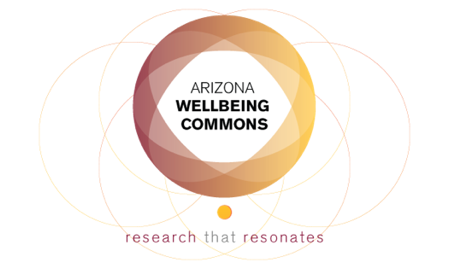
Law, Policy, and Equity Division Meeting
November 29, 2017, 9-12, ASU Law
Western Region Leaders
James Hodge, Jr., JD, LLM–James.Hodge.1@asu.edu
Madeline Morcelle, JD, MPH–mmorcelle@networkforphl.org
Sarah Wetter, JD–swetter@networkforphl.org
Exploring opportunities to move the needle in AZ health law, policy, and equity
Email for registration information
Notes:
Remind can’t proivde legal advice

Slide 69
Connecting with Policy Makers
Eric Meyer, MD, Former AZ State Representative

Slide 70
Taking Action: Where Are We,
Where Might We Go?
Take 1 Half-Sheet
WRITE
  TOP OF SHEEET: Name of your organization

Slide 71
Taking Action: Where Are We,
Where Might We Go?
Take 1 Half-Sheet
WRITE
  TOP OF SHEEET: Name of your organization
  MIDDLE: List the tactics your organization has attempted (according to the matrix) – 5 min

Slide 72
Taking Action: Where Are We,
Where Might We Go?
Take 1 Half-Sheet
WRITE
  TOP OF SHEEET: Name of your organization
  MIDDLE: List the tactics your organization has attempted (according to the matrix) – 5 min
  BOTTOM: List other tactics your organization might be able to stretch into – 5 min

Slide 73
Taking Action: Where Are We,
Where Might We Go?
On the wall-sized matrix: (10 min)
  Apply RED post-its to each tactic your organization has attempted
  Apply GREEN post-its to each tactic your organization might by able to stretch into

Slide 74
Taking Action: Where Are We,
Where Might We Go?
  REFLECT ON THE WALL
  What stands out?
  Upon which audiences do we focus our advocacy?
  Where do we have collective strength?
  Where might we develop additional advocacy capacity?

Slide 75
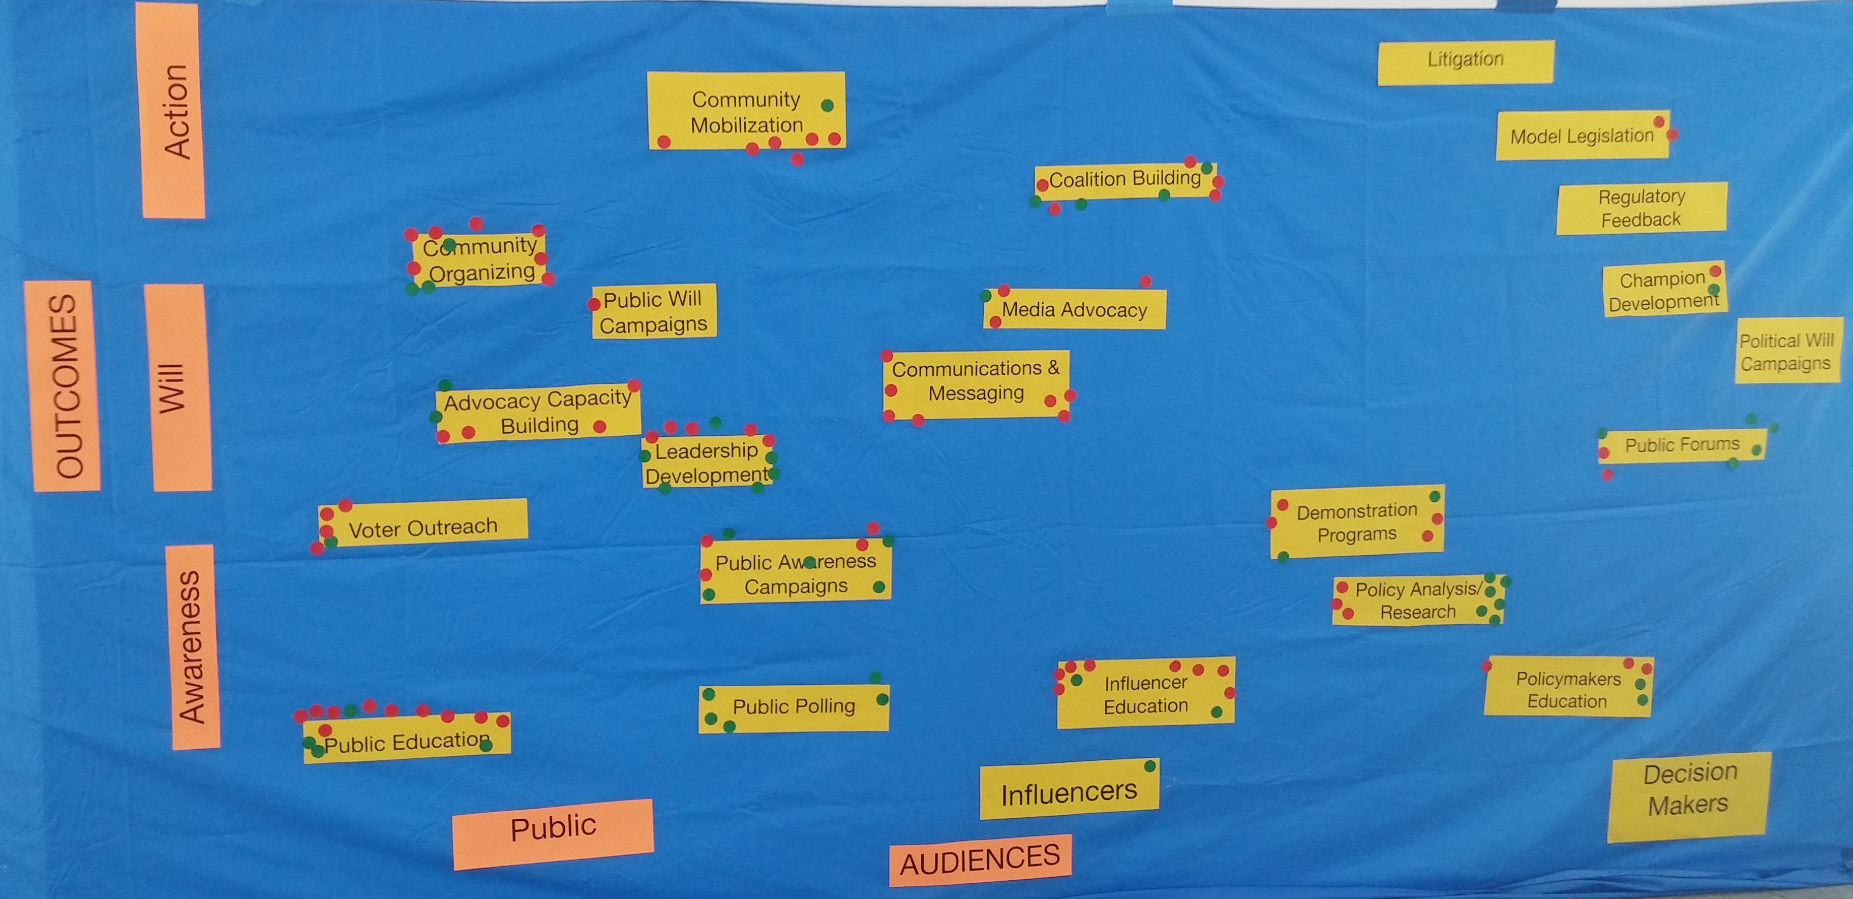
Questions/Announcements
Observations:
Most current work targeted toward public and influencers
Perceptions of organizational potential to ‘stretch’ into new areas are focused on Policy Analysis/Research, Public Forums, Leadership Development, Polling and Public Awareness Campaigns

