Slide 1

Advocacy: The Resources
Change Agent Network Forum
August 24, 2017

Slide 2
Welcome
Notes:
NAME: Raquel
NOTE: NA
SCRIPT: NA

Slide 3




Why CAN Forums?
Change starts with an initial, often highly personal, commitment to engage and move forward.
-Dr. Paul Light, Driving Social Change, 2011
Notes:
NAME: Raquel
NOTE: NA
SCRIPT: CAN Forums were created to strengthen a network of change agents.
Vitalyst’s goal is for you to leave today’s session knowing other people, knowing that you are not alone, and with some practical skills and resources to build a stronger more effective organization.
This starts with self , like a drop in the water, and has the possibility of becoming a wave of transformation.

Slide 4


CAN Forum
Continual Learning
-
Self Motivation
Notes:
NAME: Raquel
NOTE: NA
SCRIPT: Please keep in mind. CAN Forums are a high level introduction to subjects that are often complex.
We respect and appreciate the diversity of experience on complex topics because it enriches the conversation, connects people with others who may have a different skill set and lived experience,
and because acknowledging together that something is complex is one step to knowing we are all in this together.

Slide 5
Agenda
Vitalyst Health Foundation overview
Year of Healthy Communities
Table introductions
CAN Forums 2017
Desired results for today
Guest presenter, David Martinez
Notes:
NAME: Jennifer
NOTE: NA
SCRIPT: NA

Slide 6
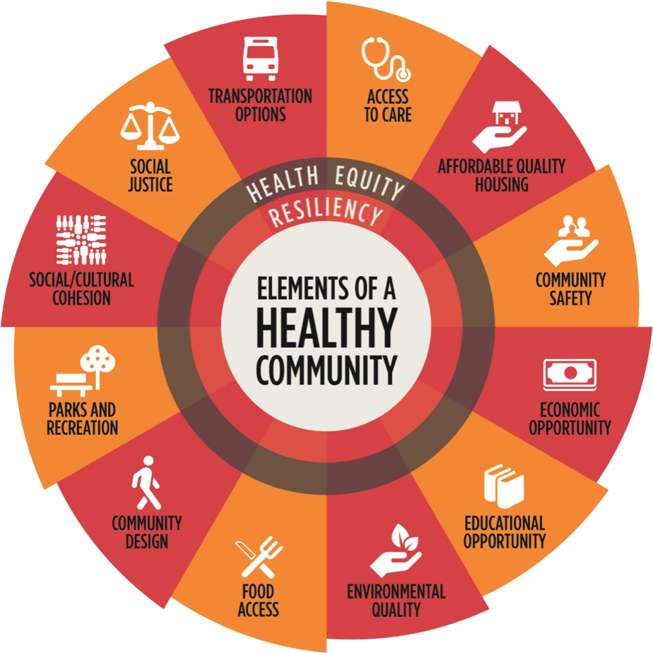
Table Introductions
Name
Organization/Affiliation
Briefly describe where your work fits into the Elements of Healthy Community
August 24, 2017
Notes:
NAME: Jennifer
NOTE: Refer to the handout in their folders
SCRIPT: Please share your name, organization, and where your work fits into the elements of healthy communities- just among your table.

Slide 7
2017 CAN Forums: Advocacy
YEAR OF HEALTHY COMMUNITIES
ADVOCACY
The Story | The People | The Resources | The Action
February 21, 2017 | May 25, 2017 | August 24, 2017 | November 16, 2017
Desert Willow Conference Center | Roosevelt Wellness Center | Roosevelt Wellness Center | Roosevelt Wellness Center
Building the story | Building the people | Building and aligning resources | Taking action
Notes:
NAME: Jennifer
NOTE: This is not in their folder. We can have it on the website.
SCRIPT: Here is our learning arc for this year’s CAN Forum.

Slide 8
Specific Desired Results of Today’s Session
Identify various types of resources involved in advocacy: financial, partners, media, etc.
Discuss the impact of building resources on advocacy
Describe how resources from partners may be leveraged
Describe how organization values may be created and/or aligned to advocacy cause
Create organizational priorities in advocacy
Discuss partner alignment with organizational priorities
Identify sources for funding and/or other resource support
Notes:
NAME: Jennifer
NOTE: None
SCRIPT: Desired results set the ground for expectations about what we are trying to achieve in this session…

Slide 9
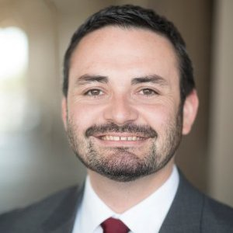
Guest Presenter
David Martinez, III
Advocacy & Outreach Specialist
St. Mary’s Food Bank Alliance

Slide 10


Building Resources to Effectively Advocate
Vitalyst Health Foundation
August 24, 2017
David Martinez III
Advocacy & Outreach Specialist
St. Mary’s Food Bank Alliance
@SMFBadvocate

Slide 11
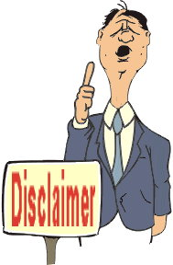
I am not:
An attorney
An accountant
I am:
A teacher
A congressional intern
A community organizer
A state lobbyist

Slide 12
Step 1
Understanding what advocacy is

Slide 13
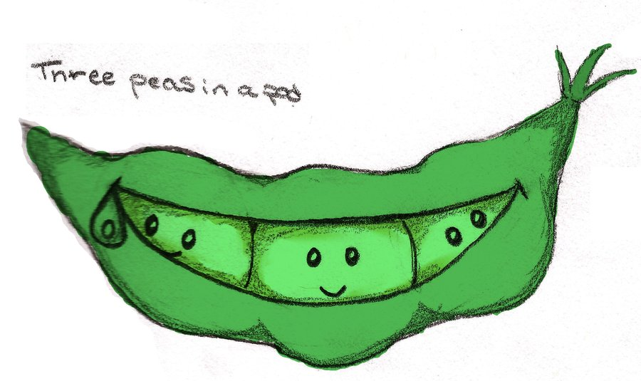
Advocacy 101
What is advocacy?
The active support of a cause
The process by which you influence policymakers
Yes, it is LOBBYING!
But also, it is collective action
We advocate via…
Programs
Education
Advocacy
Public charities can lobby under federal law!
Lobbying:
Communications that are intended
to influence specific legislation

Slide 14
Step 2
Understand why we should advocate

Slide 15

Advocacy 101
1. It’s in our mission and/or strategic goals!
OUR MISSION
To alleviate hunger through the gathering and distribution of food while encouraging self-sufficiency, collaboration, advocacy and education.
2. There is a clear ROI
National Committee for Responsive Philanthropy
$1 investment : $115 community benefit

Slide 16
Step 2…3
Understand why we should advocate
Develop your advocacy priorities

Slide 17
2017 Advocacy Priorities
Anti-Hunger, Nutrition & Health Programs
Long-standing bipartisan commitment to protect and strengthen nutrition programs from budget cuts and harmful policy changes must be maintained. Efforts that ensure healthy local food access
should be preserved and promoted.
2. Tax Provisions that Encourage Food & Fund Donations
Food banks rely on support from a variety of sources,
including individual giving, government commodities,
and donations for all segments of the food industry.
Tax policy plays a key role in the fight against hunger
and helps reduce waste.
3. Child Nutrition Programs
Child nutrition programs that serve children
in school, afterschool, and during the summer
are critical investments in our children’s health and well-being.
Notes:
If there is a work sheet for this or a process for how an organization comes up with the priorities. Also, can you discuss and share a process with how to ensure that an individual organization’s priorities align with partner organizations.

Slide 18
Let’s Try It!
Break into small groups and
let’s try building a plan of action

Slide 19
Step 4
Plan!
(failing to plan is planning to fail)

Slide 20
Advocacy Benchmarks
  1. Engaging with elected officials
  2. Recruiting and mobilizing grassroots support
  3. Recruiting and mobilizing grasstops allies
  4. Leveraging local media
  5. Building partnerships

Slide 21
Step 5
Do it!

Slide 22
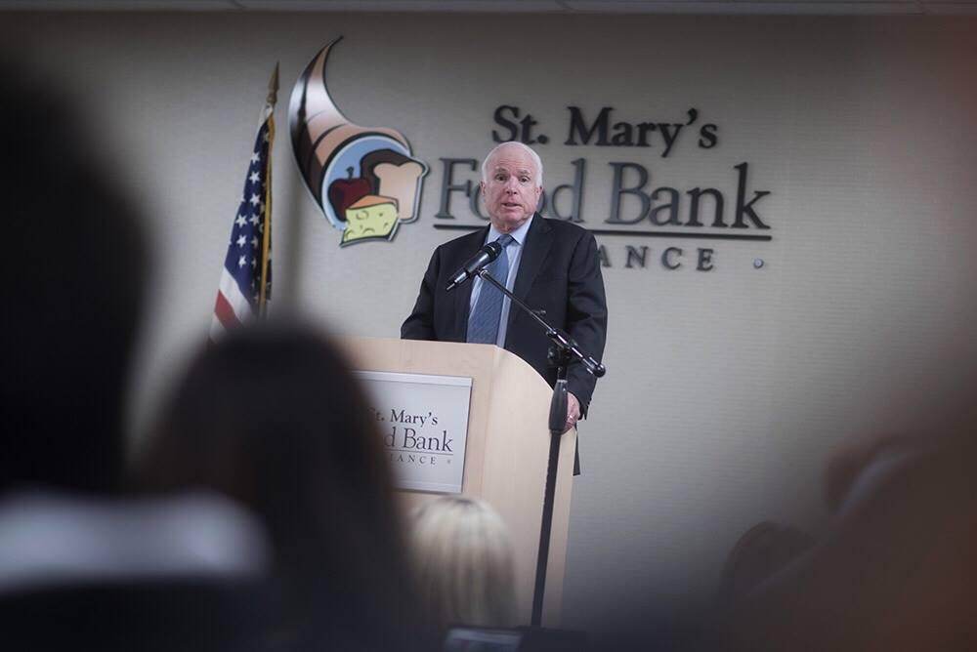
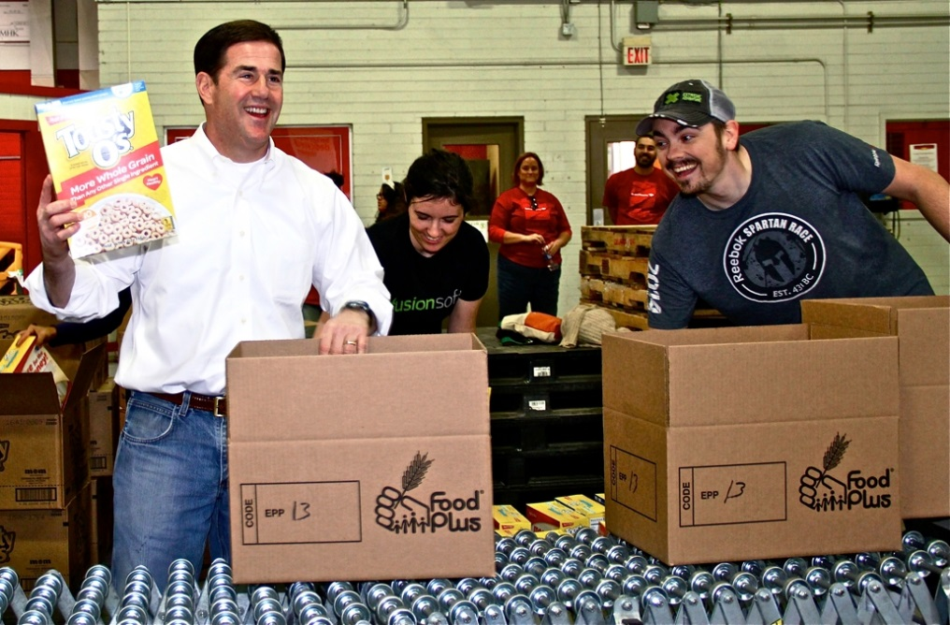
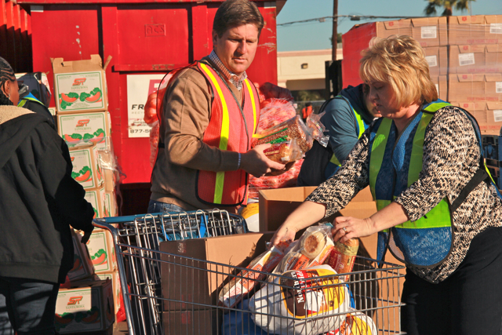
1. Engaging Elected Officials

Slide 23
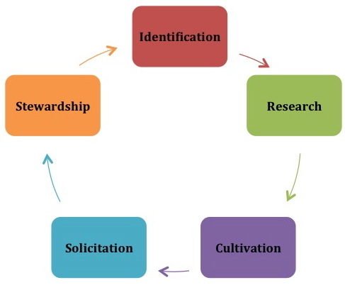
Making “Cents” of Advocacy
Donor Development
Moves Management Model

Slide 24
Advocacy Portfolio
  Based on policy priorities
  Based on service territory
  Based on position of power
  Based on connection to your nonprofit
  Based on interest

Slide 25
Let’s Try It!
Break into small groups and
let’s try building a plan of action

Slide 26

How to Engage
We Should Advocate Based on Proven Strategies
“We in America do not have government by the majority. We have government by the majority who participate.”
- Thomas Jefferson

Slide 28


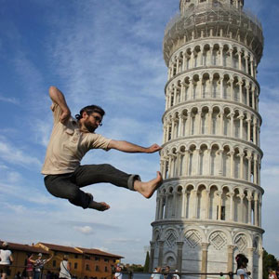

Slide 29
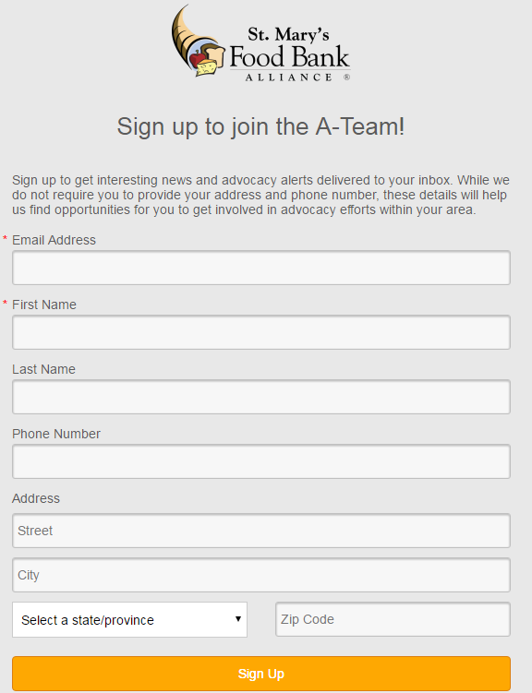
2. Mobilizing Grassroots
  Phone2Action
  SalsaLabs
  Depends on your advocacy needs and existing CRM software, tools like this can be a useful investment

Slide 30
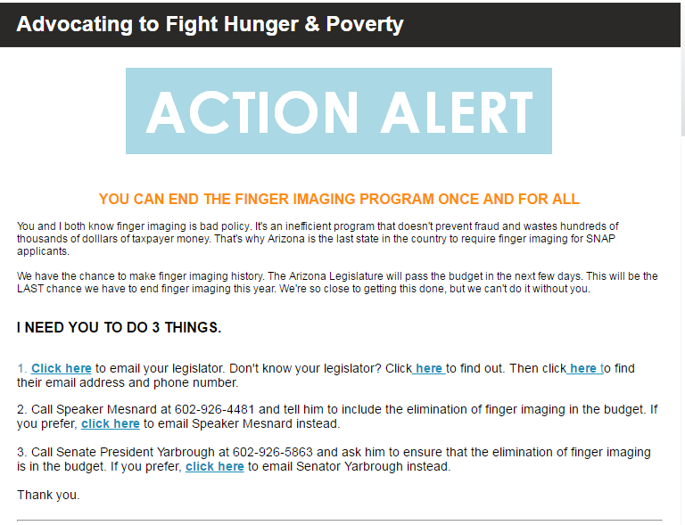
2. Mobilizing Grassroots

Slide 32
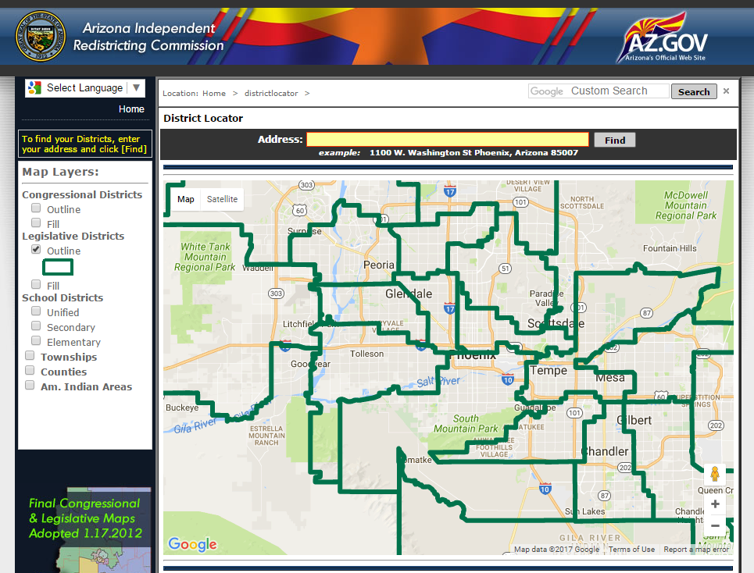
3. Mobilizing Grasstops

Slide 33
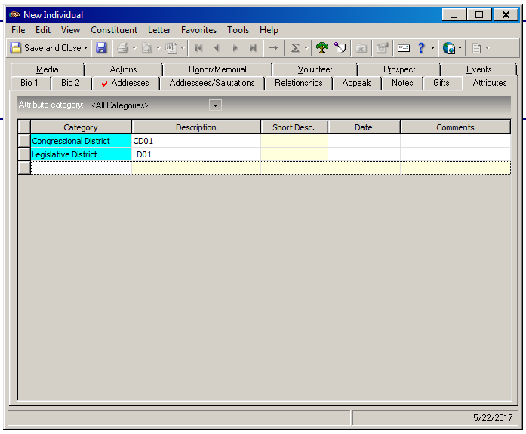
3. Mobilizing Grasstops

Slide 34
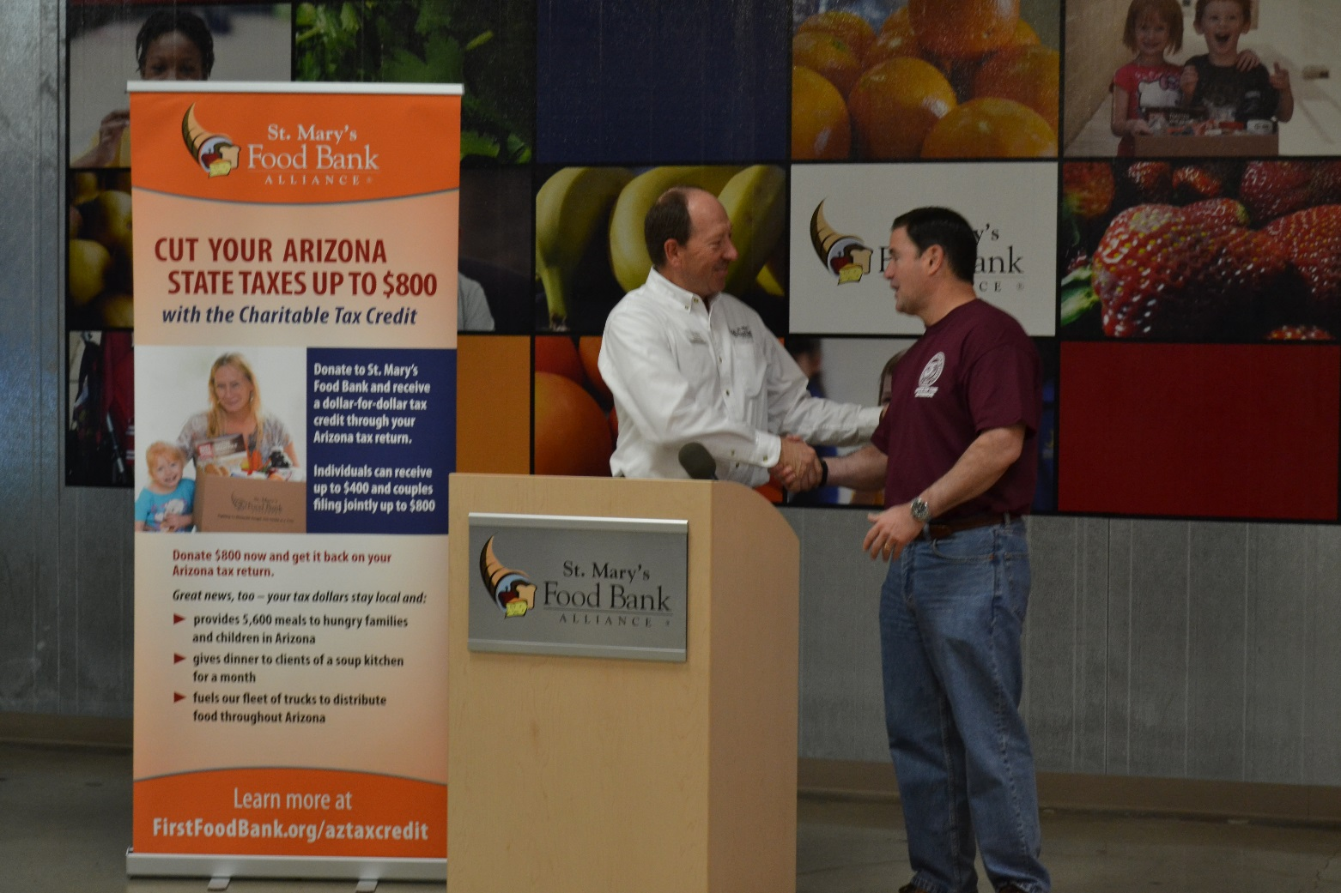
4. Leverage Local Media
  Earn media, but get the elected officials ok!

Slide 35
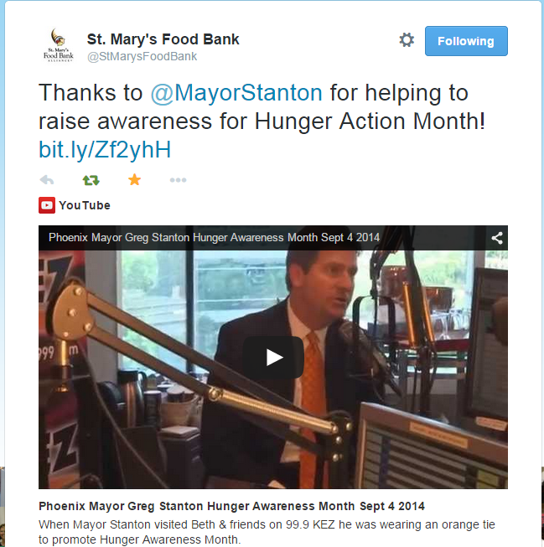
  Give them talking points

Slide 36
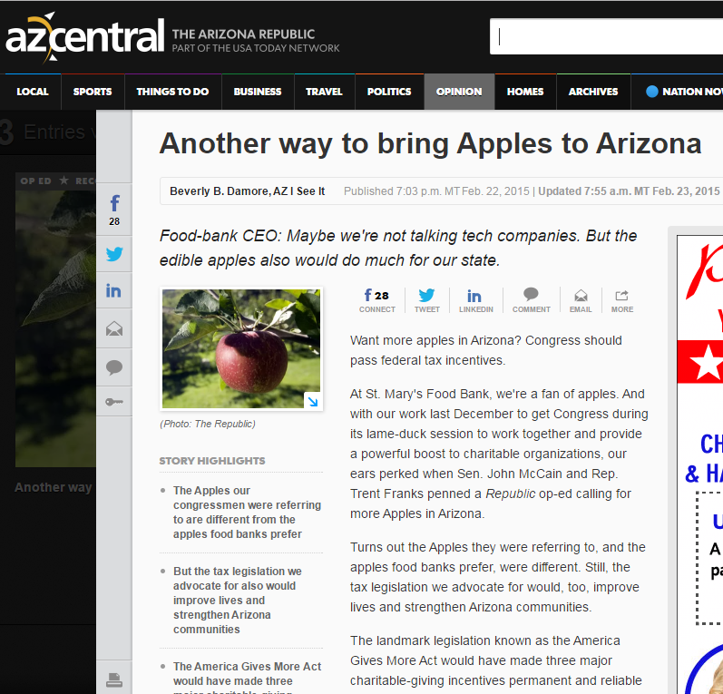
  Call them out in creative ways

Slide 37
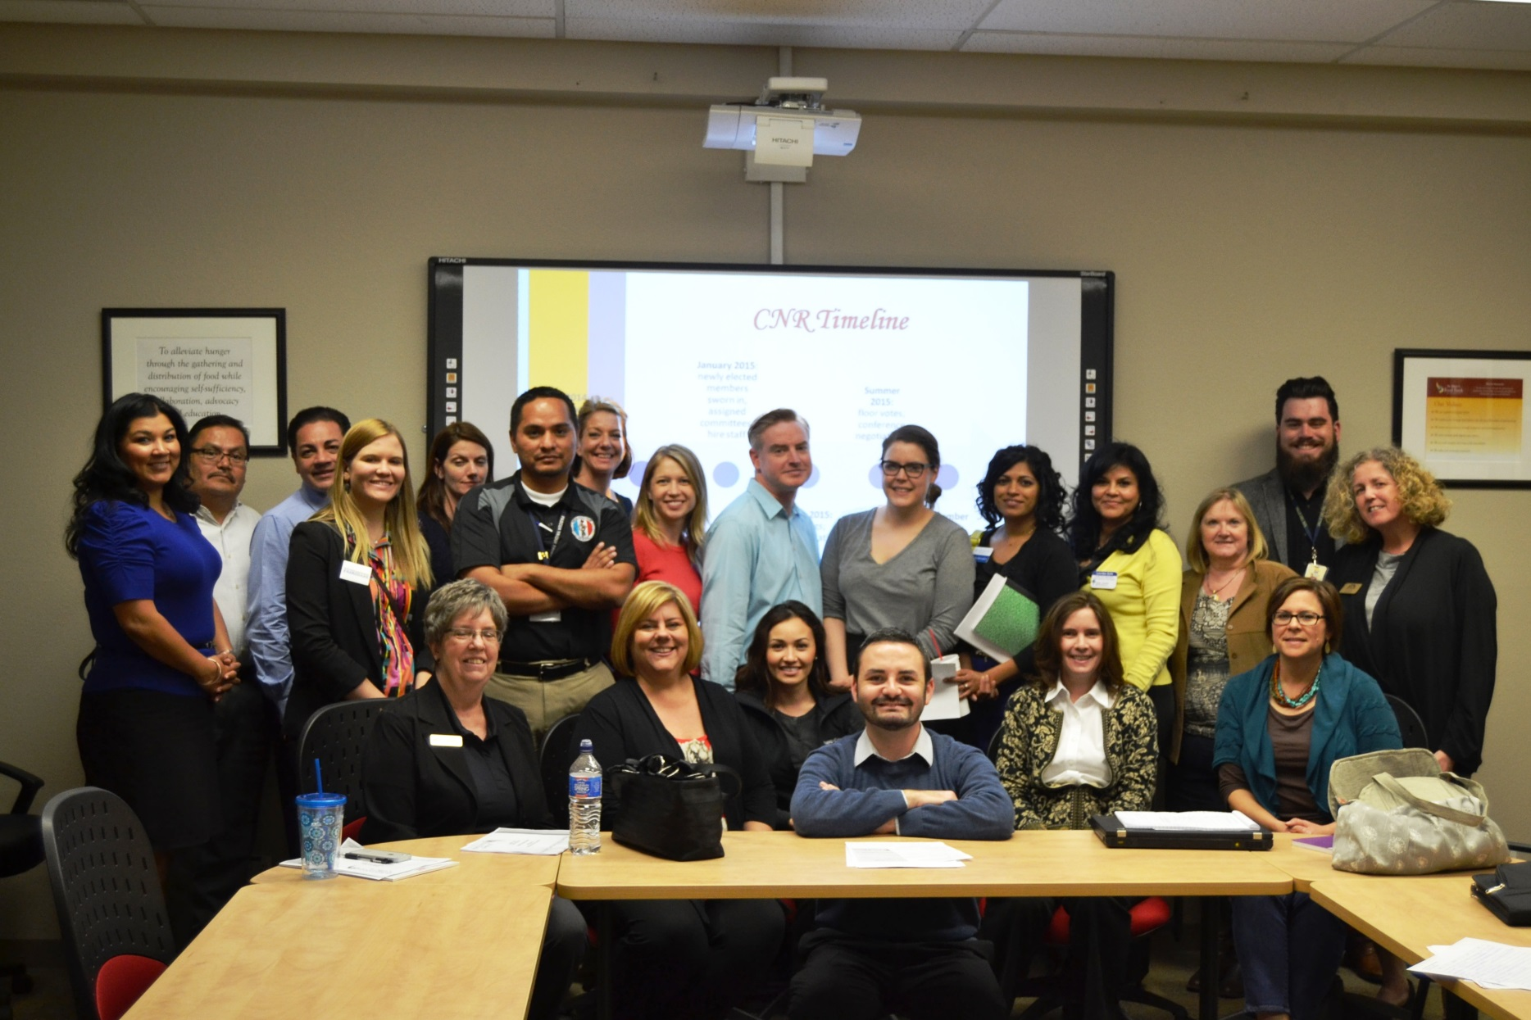
5. Build partnerships
  On your priorities. 2. If none exist, build it!
Notes:
How do we identify who the partners may be? How do we build those shared priorities?

Slide 38
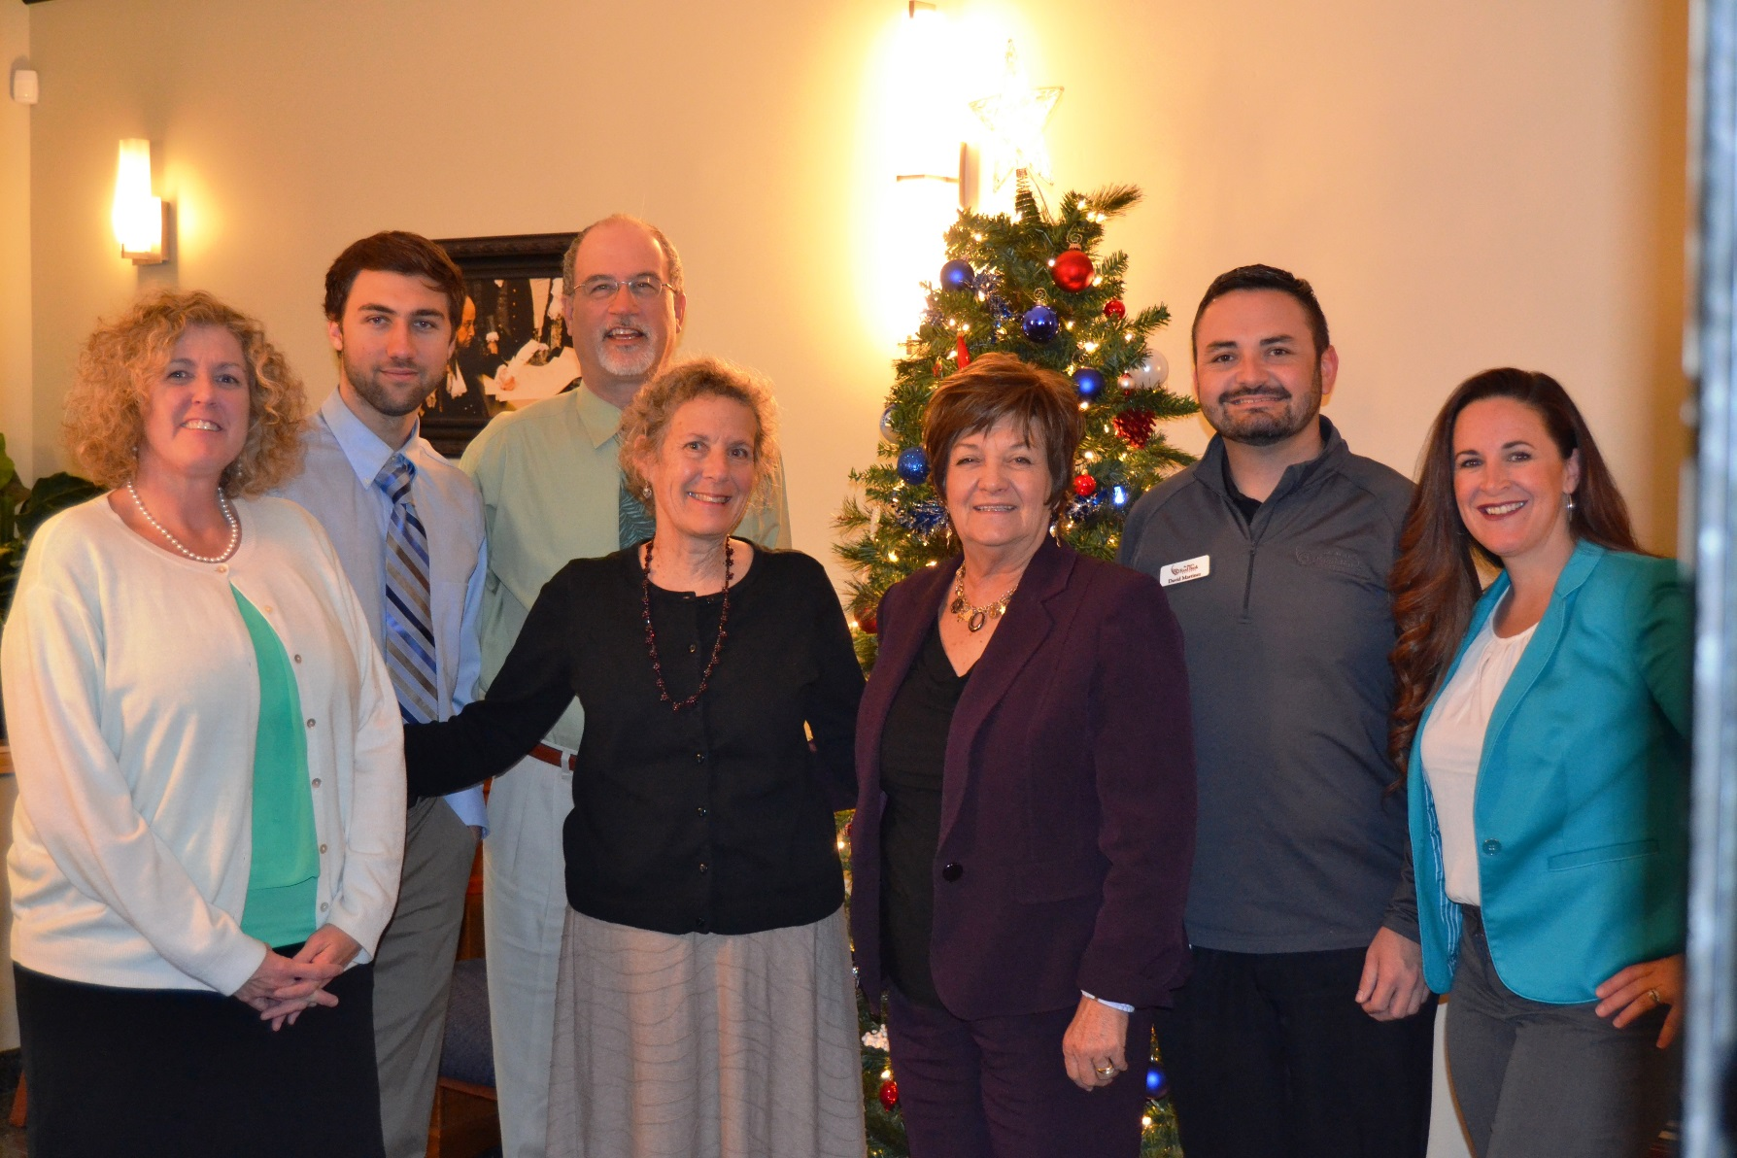
5. Build partnerships
  Remember, constituents matter!

Slide 39
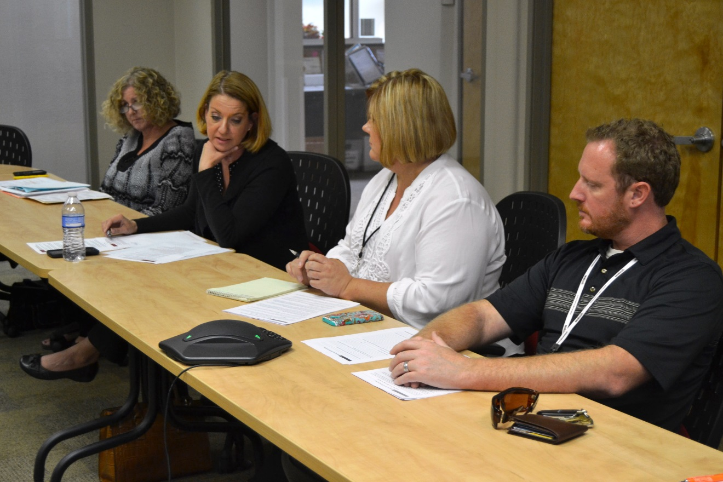
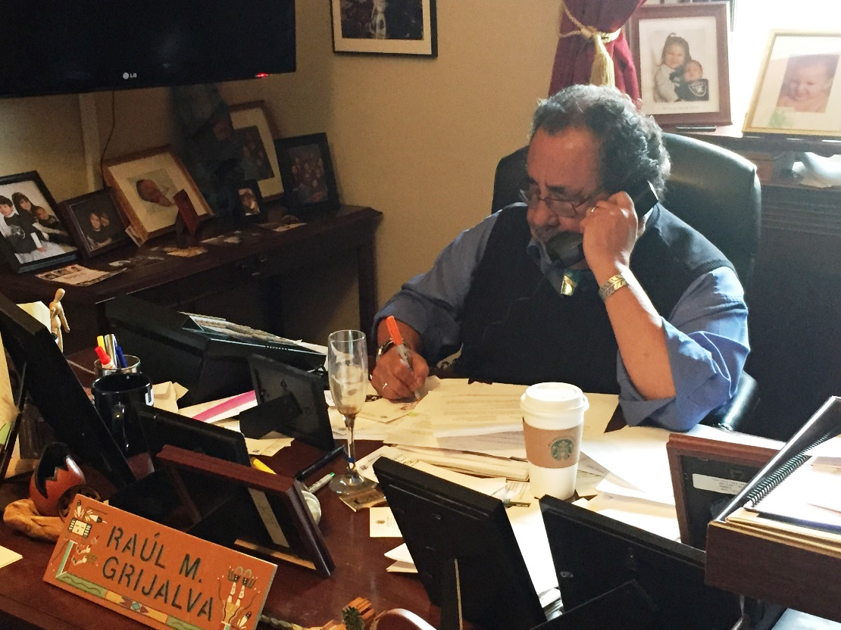
5. Build partnerships
  Include
  subject mater experts
Notes:
How do we build the resource on finding and engaging subject experts?

Slide 40
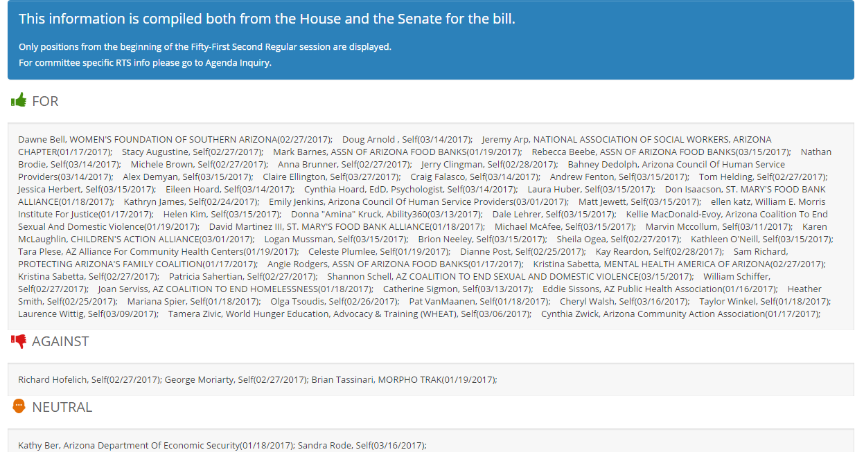
5. Build partnerships
  Power in numbers

Slide 41
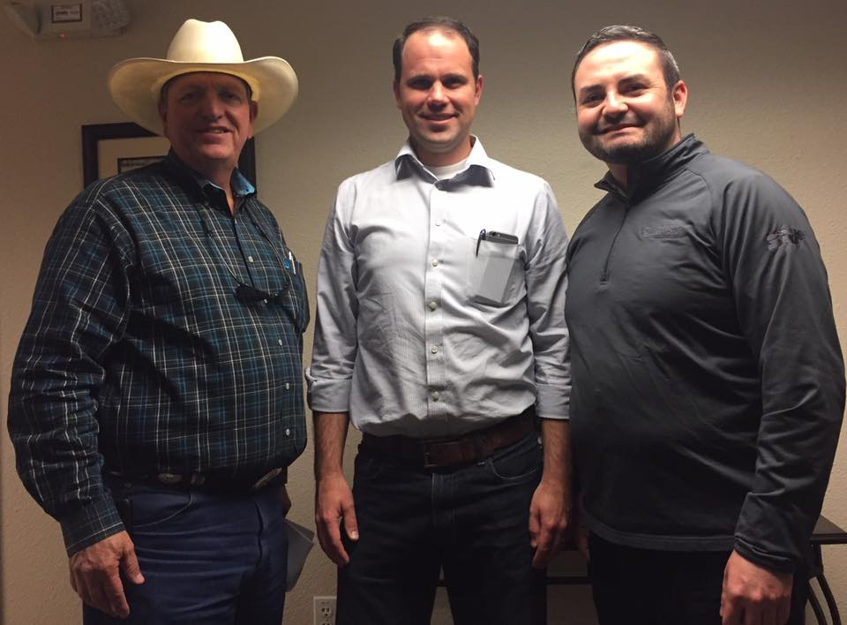
5. Build partnerships
  Data along just doesn’t cut it

Slide 42
5. Build partnerships
Checklist for Evaluating Potential Partnership:
Is there a need for a partnership?
What organizations & collective benefits to be gained?
Is someone else already doing something?
Is there a commitment from partner organizations?
What strategies/priorities will partners support?
Notes:
So how do you build partnerships?
The Compassionate Capital Fund (CCF), administered by the U.S. DHHS, provided capacity building grants to expand and strengthen the role of nonprofits organizations in their ability to provide social services to low-income individuals.
CCF National Resources Center provided training and technical assistance to all CCF grantees.
The Partnerships: Framework for Working Together guidebooks helps any organization or coalition of organizations that want to know more about establishing and managing partnerships.
Checklist for evaluating potential partnerships (“Strengthening Nonprofits: A Capacity Builder’s Resource Library. Partnerships: Frameworks for Working Together”)
Is there a need for a partnership?
On what basis is the partnership being set up? Is there a group of like-minded people with a shared vision who have decided that developing a partnership is the only route to achieve a goal? Are potential partners willing to support this?
CNR: up for renewal, unique opportunity
ACTC: up for renewal, past efforts failed, losing its value
What organizations and collective benefits will be gained from setting up this partnership arrangement?
Are there clearly identified goals that only a partnership agreement could help achieve? What is the “added value” for potential partners? What is your – and their – organizations self-interest? Are they willing to sign up for this? What exactly is the partnerships trying to achieve? How will involving others help the partnership to achieve its goals?
CNR: all federal child nutrition programs in AZ under CNR and influential CN advocates
ACTC: all major recipients of WPTC and in strategic LDs
Is someone else already doing something similar?
Do other organizations have similar or the same goals? If so, have you considered approaching them to become part of their partnership agreement to ensure work is not duplicated? If this is not appropriate or feasible, think about incorporating lessons they have learned into the new partnership agreements.
CNR: individual groups doing own thing
ACTC: passed failed efforts
Is there a commitment from partner organizations to support the partnership?
Have you approached partner organizations with the possibility of setting up a partnership? Was their response positive? Was such a proposal supported at a high level and a clear commitment given to this?
CNR: agreed upon policy priorities
ACTC: agreed upon policy brief
What strategies/local priorities will this partnership support?
Consideration needs to be given to not only identifying strategies and local priorities the partnership supports, but also how the partnership will link to targets and strategies of partner organizations.
CNR: paper bag campaign, monthly meetings w/ policy/communications/action updates, lobby meetings
ACTC: lobby meetings

Slide 43
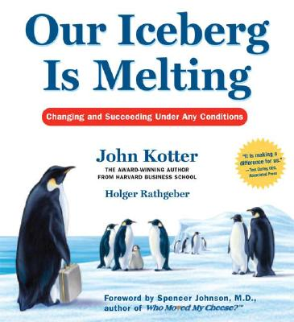
5. Build partnerships
Overview of the Eight Step Process for Successful Change

Slide 44
5. Build partnerships
Set the Stage
  Create a sense of urgency
    “In the upcoming Child Nutrition Reauthorization, Congress has an opportunity to improve access to quality, nutritious meals for millions of low-income children in childcare (CACFP), in-school (SBP, NSLP, F2S), during out-of-school time (CACFP, SFSP), and at home (WIC, FMNP).”
    “Issue: Since inception, almost 20 years ago, the credit has remained the same. … While the number of contributors, needs for services have also increased.”
Notes:
Set the stage
Create a sense of urgency: help others see the need for change and the importance of acting immediately

Slide 45
5. Build partnerships
Set the Stage
  Pull together the guiding teams
    “The Arizona Child Nutrition Coalition, comprised of 17 organizations statewide that collectively represent 65,000 children & families and served more than 165 millions meals at nearly 2,700 sites last school year…”
    The Arizona Charitable Tax Credit Coalition is supported by Valley of the Sun United Way, St. Mary’s Food Bank Alliance, Salvation Army, Goodwill, Habitat for Humanity, the Association of Arizona Food Banks, St. Vincent de Paul Society, Arizona Grantmakers Forum, Phoenix Rescue Mission, and the Alliance of Arizona Nonprofits (700+ members) advocating for nearly 600 Qualifying Charitable Organizations.
Notes:
Set the stage
Pull together the guiding teams: make sure there is a powerful group guiding the change – one with leadership skills, credibility, communication ability, authority, analytical skills, and a sense of urgency.
of urgency: help others see the need for change and the importance of acting immediately

Slide 46
5. Build partnerships
Decide What to Do
  Develop the change vision and strategy
    “The Arizona Child Nutrition Coalition will be sharing how child nutrition programs work, mobilizing our respective networks to advance our shared priorities, engaging the media to raise awareness of child nutrition efforts, and advocating to Arizona’s Congressional Delegation for Child Nutrition Reauthorization.”
    “Solution: Strengthen the Arizona Charitable Tax Credit”
Notes:
Decide what to do
Develop the change vision and strategy: change how the future will be different from the past, and how you can make that future a reality

Slide 47
5. Build partnerships
Make it Happen
  Communicate for Understanding & Buy-In
    Coalition Partner Story Template, Coalition One-Pager, Policy Priorities, Policy Brief
    Arizona Charitable Tax Credit Introductory Questionnaire, Policy Brief
Notes:
Make it happen
Communicate for understanding and buy-in: make sure as many others as possible understand and accept the vision and the strategy.

Slide 48
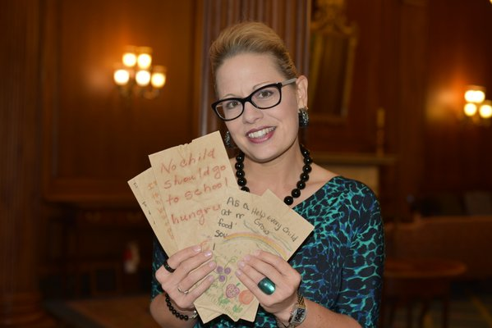
5. Build partnerships
Make it Happen
  Empower Others to Act
    Paper Bag Campaign
Notes:
Empower others to act: remove as many barriers as possible so that those who want to make the vision a reality can do so.

Slide 49
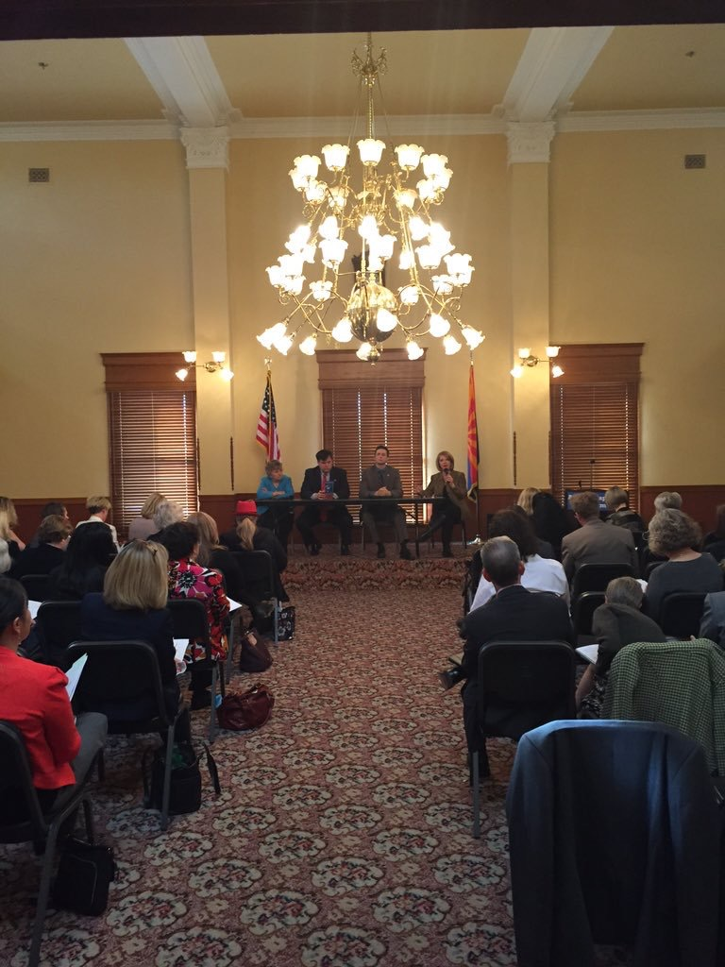
5. Build partnerships
Make it Happen
  Empower Others to Act
    Nonprofit Day at the Capitol
Notes:
Empower others to act: remove as many barriers as possible so that those who want to make the vision a reality can do so.

Slide 50

5. Build partnerships
Make it Happen
  Produce Short-Term Wins
    In-District Lobby Meetings
Notes:
Produce short-term wins: create some visible, unambiguous successes as soon as possible

Slide 51
5. Build partnerships
Make it Happen
  Don’t Let Up
    Monthly Meetings
Notes:
Don’t let up: press harder and faster after the first successes. Be relentless with initiating change after change until the vision is a reality.

Slide 52
5. Build partnerships
Make it Stick
  Create a new culture
    Innovative behavior: https://youtu.be/qWeOygiXDiI
    The hard part…
Notes:
Make it stick
Create a new culture: hold on to the new ways of behaving, and make sure they succeed, until they become strong enough to replace old traditions.
Challenges remain with Charitable Tax Credit
Ensure that the changes would not be overcome by stubborn, hard-to-die traditions

Slide 53
Let’s Try It!
Break into small groups and
let’s try building a plan of action

Slide 54
Advocacy Plans & Benchmarks
  Understand what advocacy is
  Understand why we should advocate
  Develop your advocacy priorities
  Plan
  Do it!
    Engaging with elected officials
    Recruiting and mobilizing grassroots support
    Recruiting and mobilizing grasstops allies
    Leveraging local media
    Building partnerships

Slide 55
Thank You!
David Martinez III
Advocacy & Outreach Specialist
St. Mary’s Food Bank Alliance
(602) 343-2554
dxmartinez@firstfoodbank.org
@SMFBadvocate

Slide 56
David Martinez III
Advocacy & Outreach Specialist
St. Mary’s Food Bank Alliance
(602) 343-2554
dxmartinez@firstfoodbank.org
@SMFBadvocate
Jennifer Bonnett, MPA
JHB Executive Consultants
jennifer@jhbconsultants.com
www.jhbconsultants.com
(602) 529-4697
Dr. Raquel Gutierrez
Director of Strategic Learning & Practice
Vitalyst Health Foundation
Rgutierrez@VitalystHealth.org
www.VitalystHealth.org
(602) 385-6500
Notes:
NAME: NA
NOTE: NA
SCRIPT: NA

