Slide 1
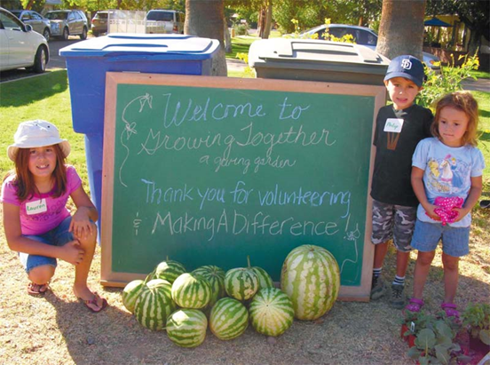
Phoenix Community Garden Policy Guidelines
Dean Brennan, FAICP

Slide 2
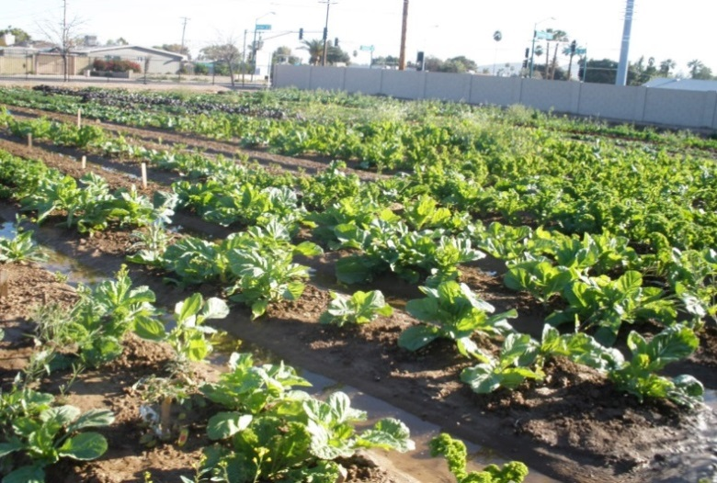
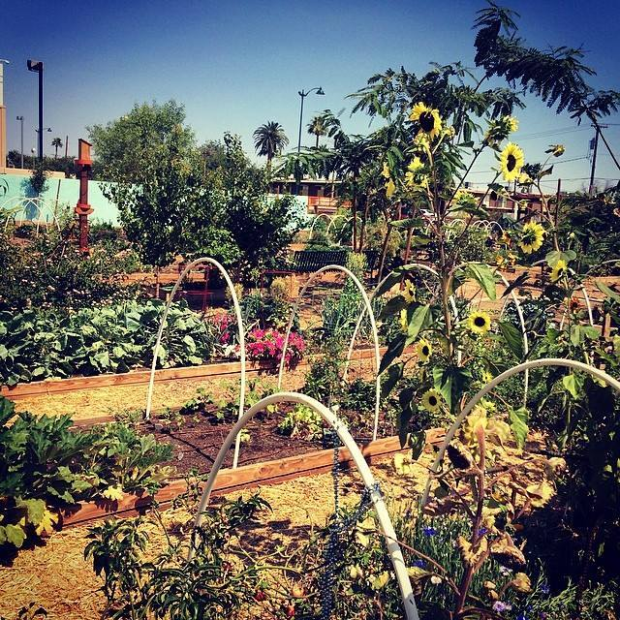
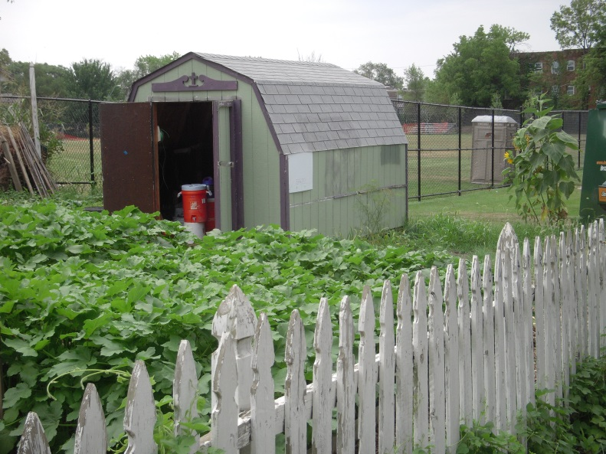
Challenge: Community Gardens – An Illegal Use!
Community gardens not permitted by Phoenix Zoning Ordinance.
Existing zoning development standards restricted potential community garden development and activities.
Lack of information for how to establish a community garden in Phoenix.

Slide 3
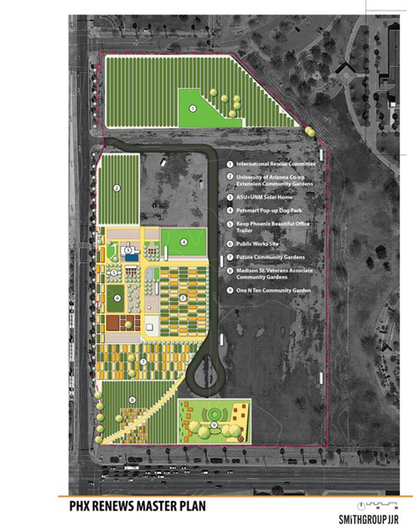
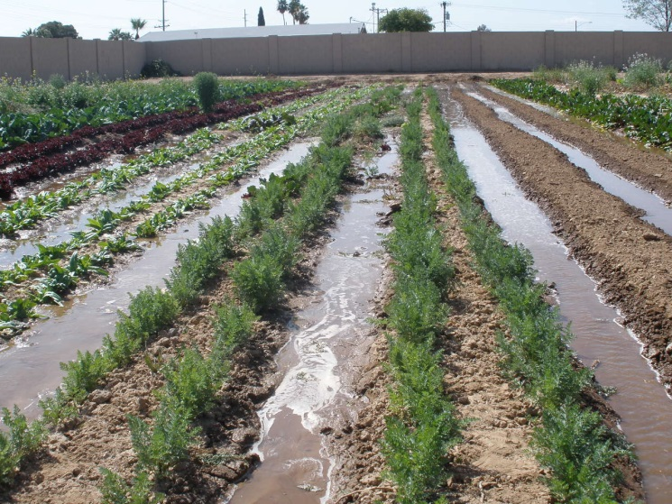
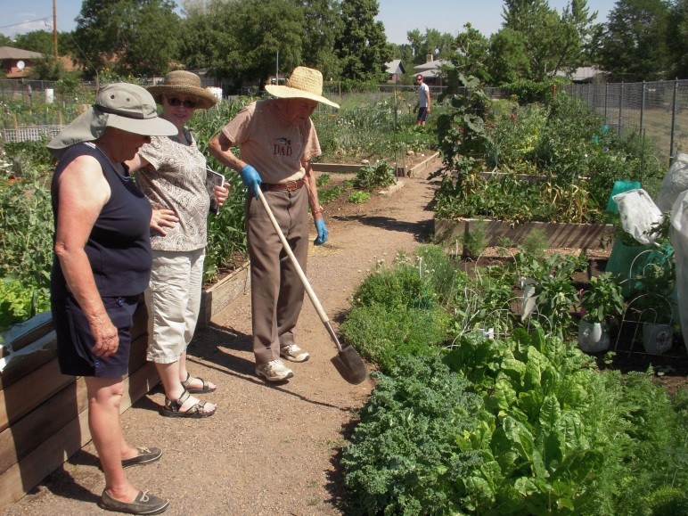
Challenge: City Budget
No city staff time available to prepare zoning ordinance amendment.
Lack of city staff expertise to prepare community garden guidelines.
Staff reductions in response to budget cuts.
“Back-burner” project.

Slide 4
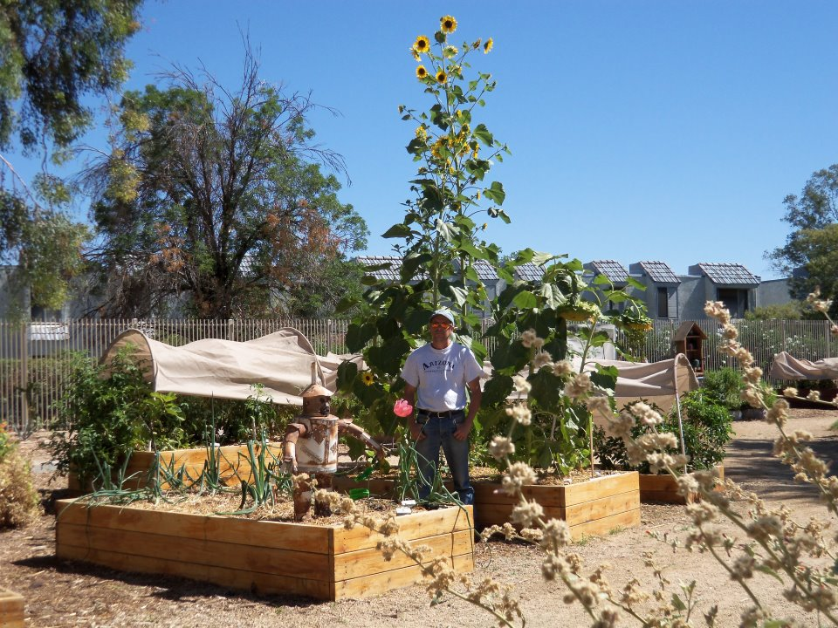
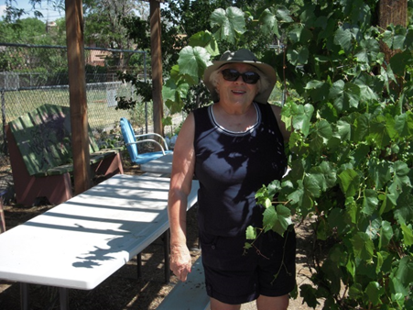
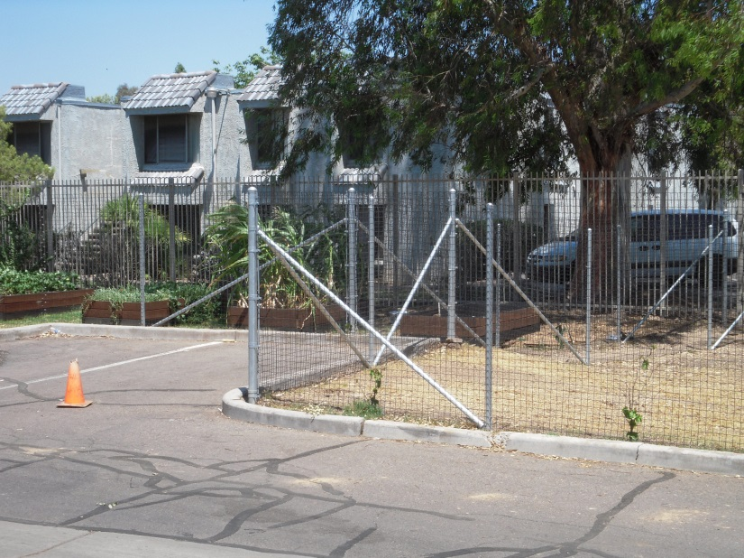
Challenge: Zoning Ordinance Standards
Zoning ordinance development standards (examples)
Fence material and height
Setbacks from adjacent properties
Restriction of on-site activities
Limitation on sale of produce

Slide 5
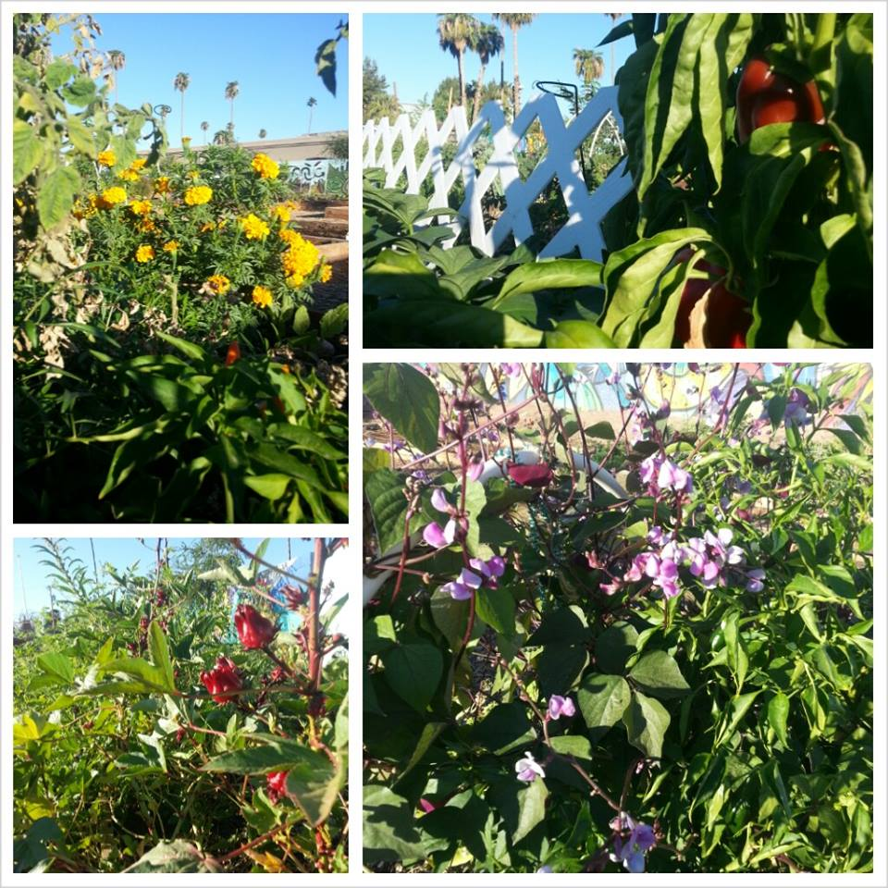
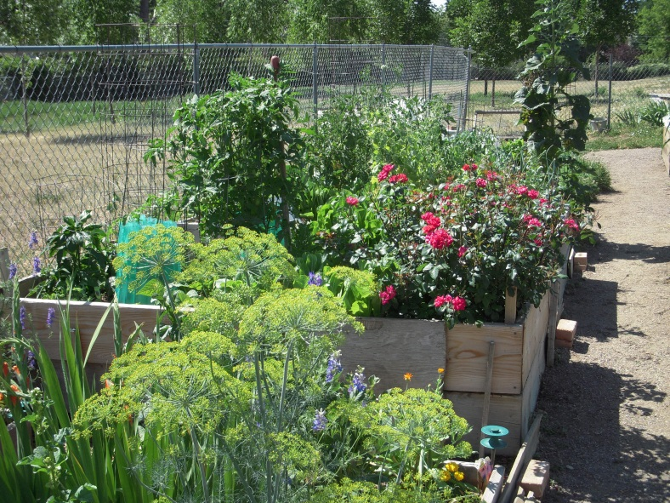
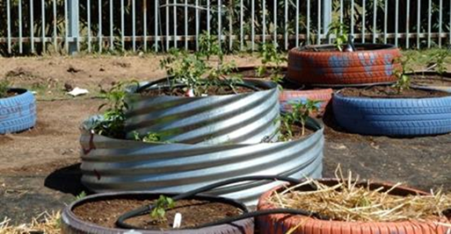
Solution: Public/Private Partnership
St. Luke’s Health Initiatives Community Garden Stakeholders Working Group – Volunteers to Prepare Policy Guidelines
Community Gardeners
Community Garden Advocates
Healthy Community Advocates
Food System Security Advocates
Healthy Food/Nutrition Advocates
Local Food Producers

Slide 6
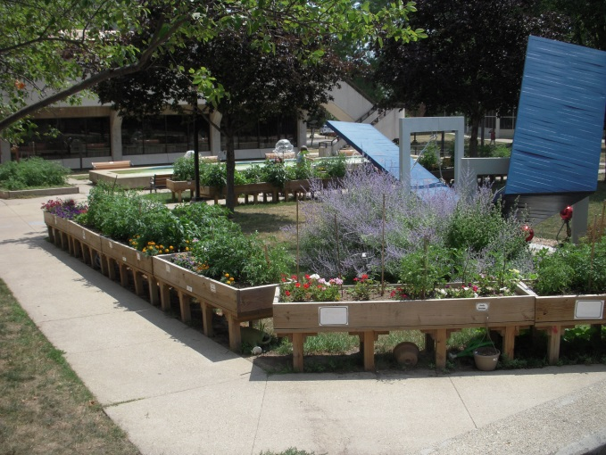
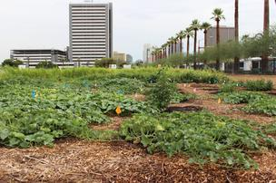
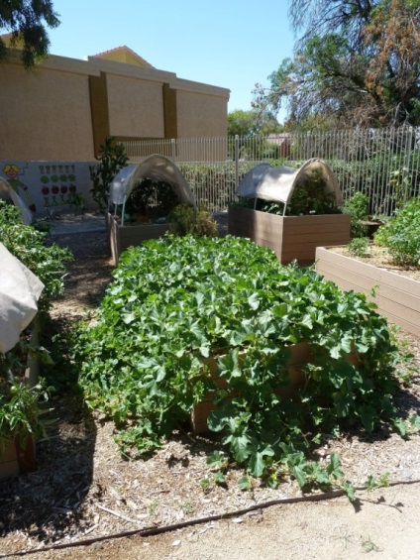
SLHI Working Group Process
Met several times to work through the issues and develop “consensus” draft policy guidelines.
Submitted draft policy guidelines to city staff for review and feedback.
Series of meetings with city staff from various departments – Planning; Development Services; Water; Sanitation; Fire; Police; Public Works; Parks and Recreation.
Worked with Planning staff to finalize policy guidelines for Planning Commission adoption. (Nov., 2012)

Slide 7
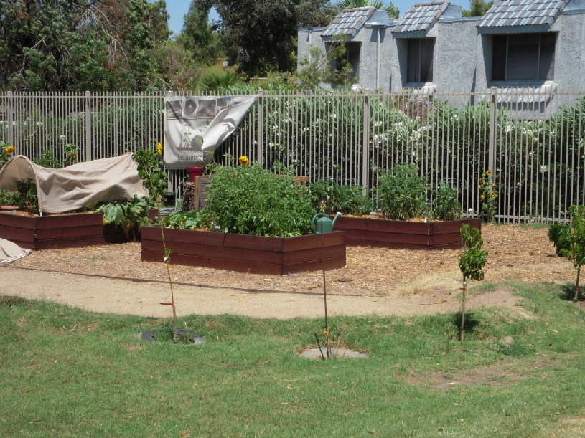
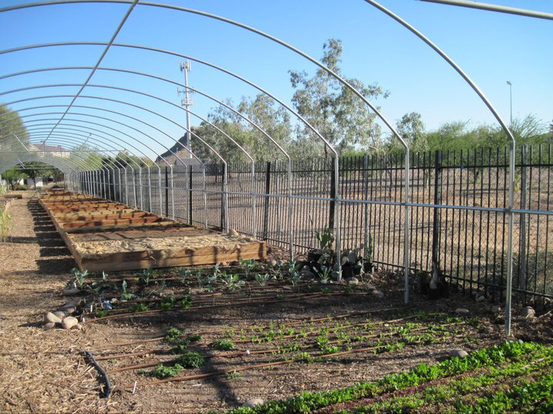
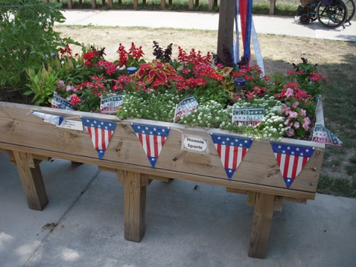
Stakeholder Issues
Community Garden = Neighborhood Asset
Site Security
On-site activities
Storage of hazardous materials
On-site storage structures
On-site composting
On-site sale of produce
Signs

Slide 8
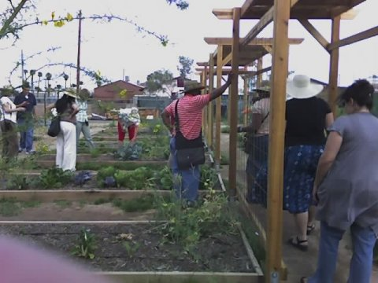
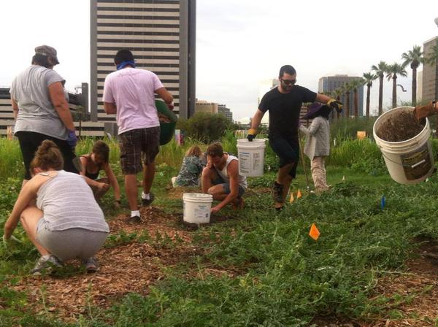
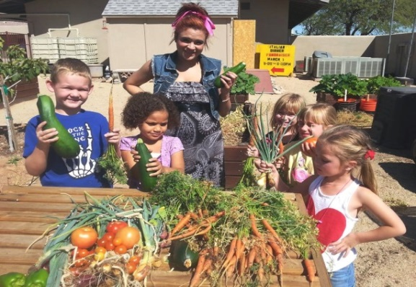
City Issues
Community Gardens = Good Neighbors
Security – fencing; lighting
Noise – music; group activities
Odors – composting
Maintenance – visual appearance
Signs – visual clutter
Drainage – runoff onto adjacent parcels
Sale of produce – traffic
On-site storage buildings – location;
appearance; setbacks

Slide 9
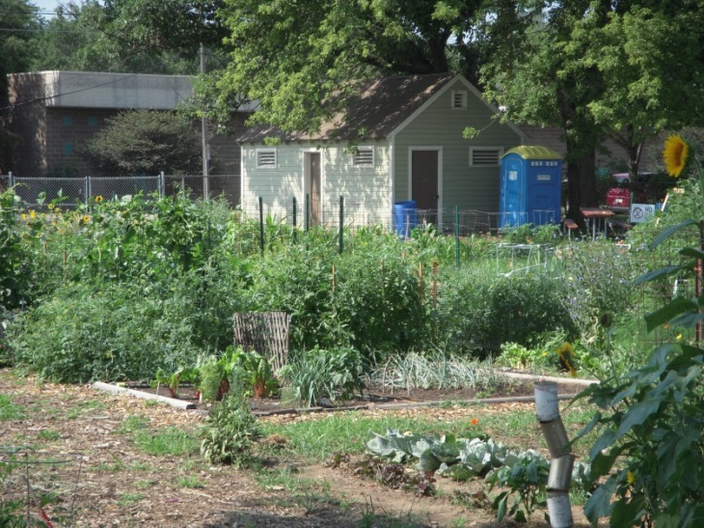
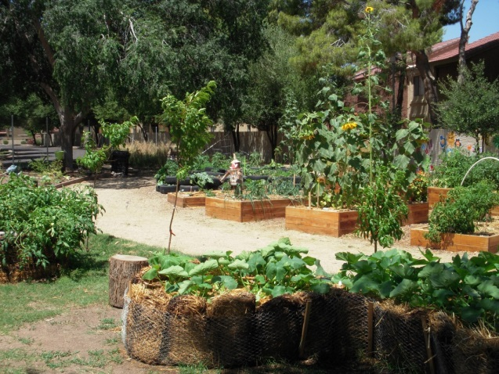
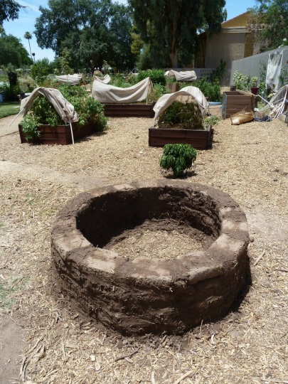
Community Garden Policy Guidelines
Highlights
Legitimize community gardens – zoning approval process.
Mitigate potential impacts on adjacent neighborhood residents.
Maintenance, noise, drainage, odors, vehicle parking, hours of operation
Allow produce sales – not permitted in residential neighborhoods.
Allow signs – not permitted in residential neighborhoods.
Critical resource and contact information provided.

Slide 10
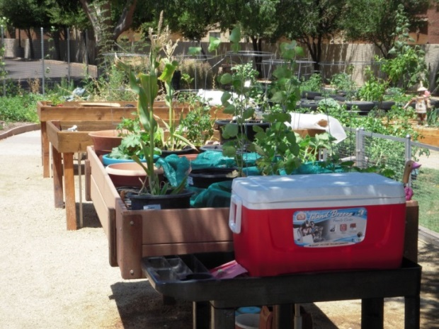
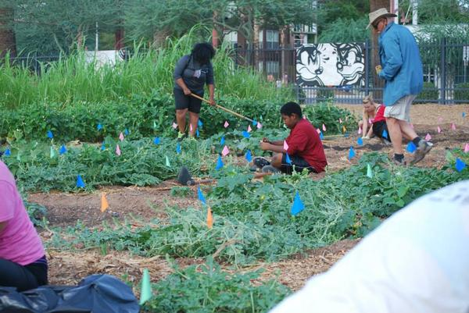
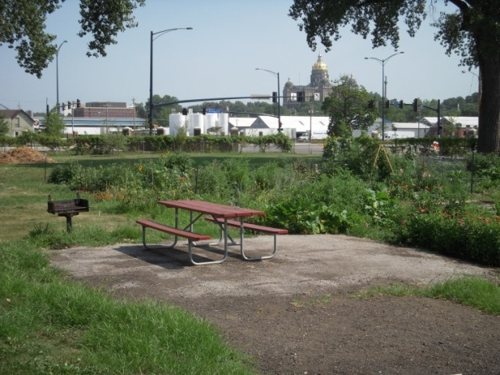
Community Garden Policy Guidelines
Highlights
Provide “design” flexibility
Security – fence materials; lighting; alarms
Keeping of animals and pollinators
Garden improvements – buildings; gathering areas; composting
Signs
On-site activities
Neighborhood gatherings
Gardening demonstrations
Education programs

Slide 11
Take-Away
Successful Collaboration – Community Garden Policy Guidelines
Success based on shared commitment by stakeholders and city staff to accommodate community gardens in Phoenix.
Success based on mutual understanding and respect.
Stakeholders understood role of staff to minimize community conflicts and balance the needs of the entire community.
Staff respected the stakeholder experience and expertise to identify essential community garden elements to be addressed in the policy guidelines.
Success based on recognition that stakeholders play a key role in public outreach and participation.
Connections to community garden knowledge base
Partnerships with healthy community advocacy groups
Leadership for building community consensus
Champions for gaining political approval

Slide 12
Resources & Contacts
American Community Garden Association (www.communitygarden.org)
From Neglected Parcels to Community Gardens: A Handbook, Wasatch Community Gardens (https://wasatchgardens.org/files/images/FromNeglectedParcelsToCommunityGardens.PDF)
Community Garden Toolkit: A Resource for Planning, Enhancing and Sustaining Your Community Gardening Project (http://www.portlandoregon.gov/parks/article/282909)
I Love My P-Patch: A Community Garden Leadership Handbook from Seattle (http://www.seattle.gov/neighborhoods/ppatch/pubs/P-Patch%20Leadership%20Handbook%202009.pdf)
Gardeners' Welcome Packet: A Template for Community Garden Organizers (http://extension.missouri.edu/explorepdf/miscpubs/mp0906welcome.pdf)
Phoenix Community Garden Policy Guidelines (www.phoenix.gov/planning)
Contact: Dean Brennan, FAICP – dbrennan.plc@cox.net; 480-390-9185

Slide 13
Phoenix Community Garden Policy Guidelines
Thank You!
Dean Brennan, FAICP

